Slide 1
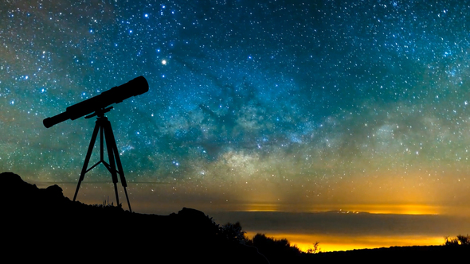
The Telescope

Slide 2
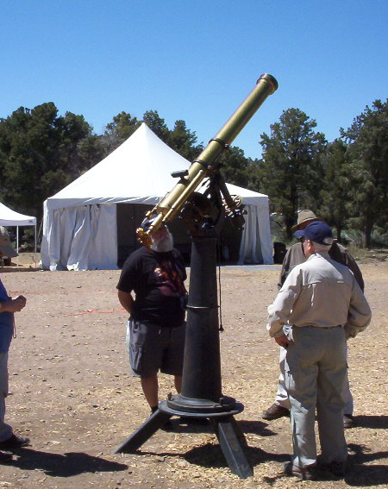
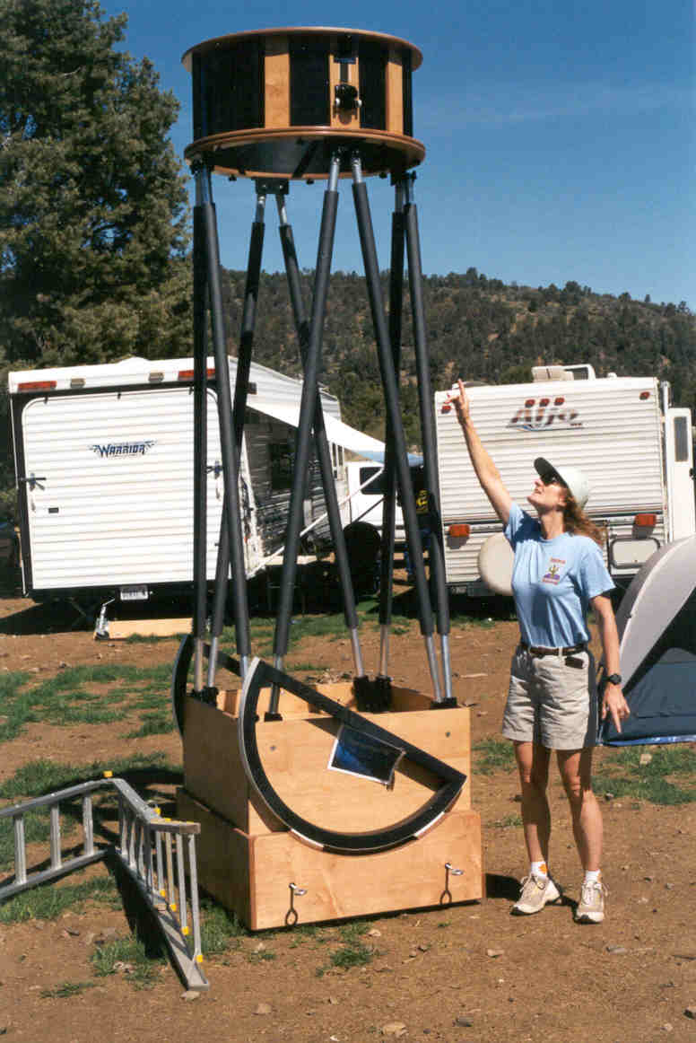
The Telescope
Telescopes come in a variety of forms.
Some small, some big, some short, some long!

Slide 3
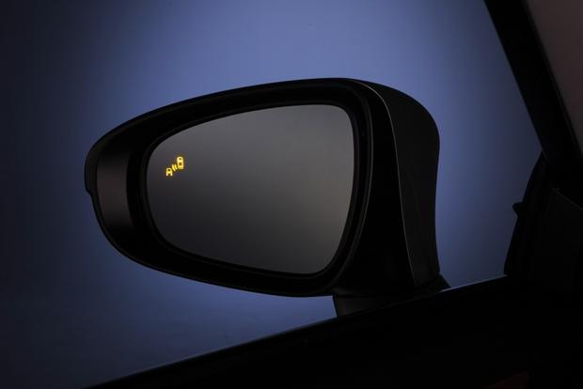
The Telescope
What is a Telescope?
Tele = at a distance, scope = to see
Makes distant objects appear closer.
Objects in mirror are farther than they appear!

Slide 4
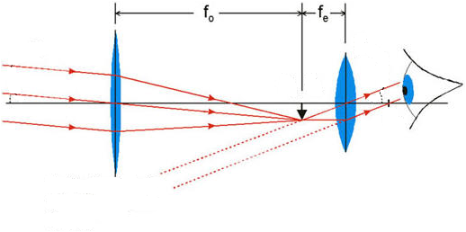
The Telescope
What is a Telescope?
Tele = distant, scope = to see
Makes distant objects appear closer.
The "objective" forms a little image of a small part of the sky.
The "eyepiece" then magnifies the image.
Magnification is the combination of telescope & eyepiece focal lengths.
Mag = f_{tel} / f_{eye}

Slide 5
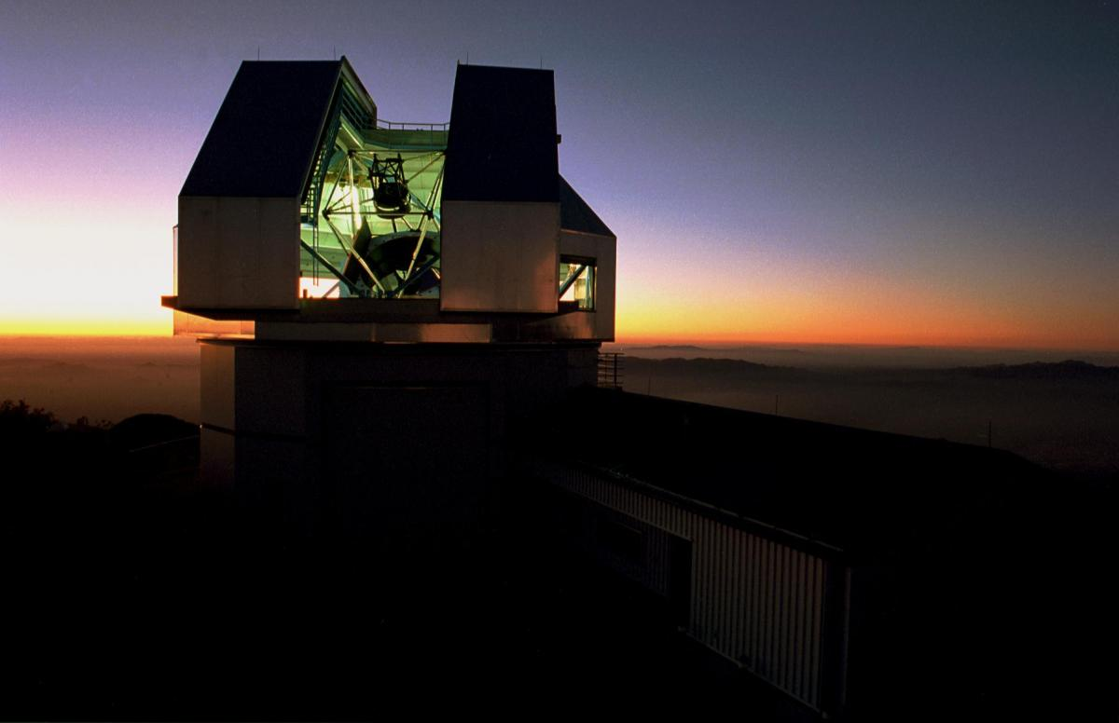
The Telescope
What is a Telescope?
Tele = distant, scope = to see
Makes distant objects appear closer.
The "objective" forms a little image of a small part of the sky.
The "eyepiece" then magnifies the image.
Magnification is the combination of telescope & eyepiece focal lengths.
Mag = f_{tel} / f_{eye}
It's aperture, not magnification, that is the primary defining characteristic.
- Greater aperture gives more collecting area & resolution. (See fainter & sharper!)

Slide 6
The Telescope
What is a Telescope?
Tele = distant, scope = to see
Makes distant objects appear closer.
The "objective" forms a little image of a small part of the sky.
The "eyepiece" then magnifies the image.
Magnification is the combination of telescope & eyepiece focal lengths.
Mag = f_{tel} / f_{eye}
It's aperture, not magnification, that is the primary defining characteristic.
- Greater aperture gives more collecting area & resolution. (See fainter & sharper!)
Bigger always better!

Slide 7
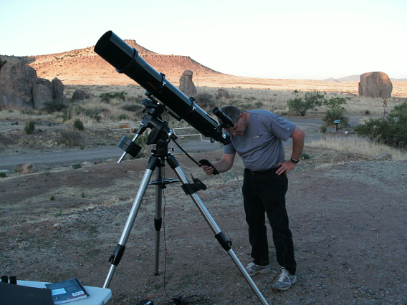
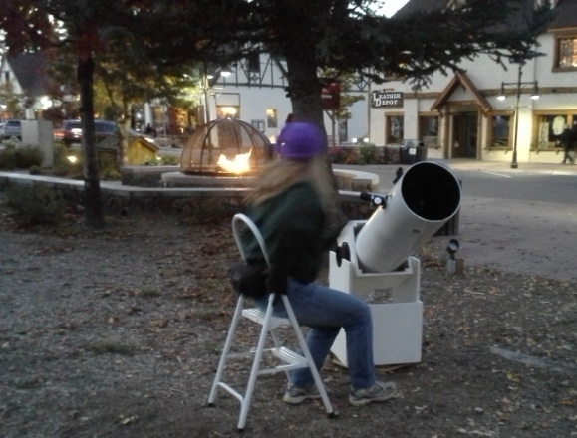
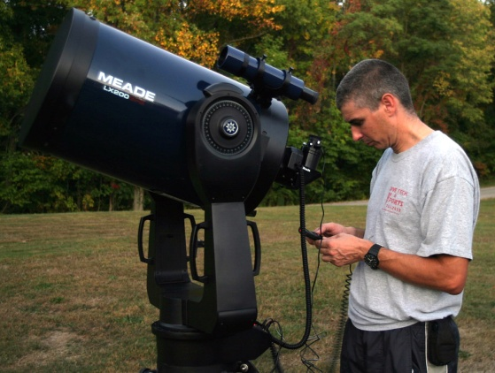
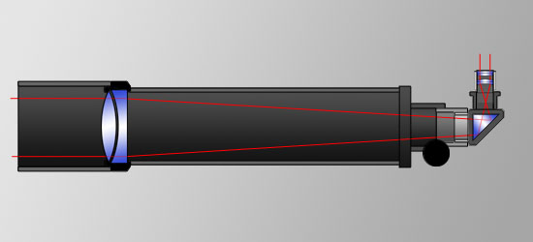
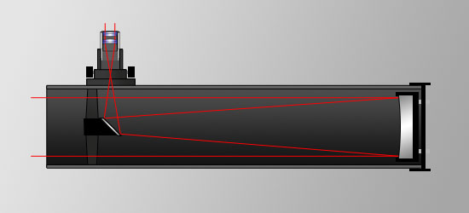
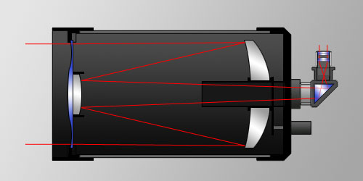
The Telescope
Three common types of Telescopes
Refractor Reflector Catadiotric
(Lens) (Mirror) (Mirror & Lens)

Slide 8
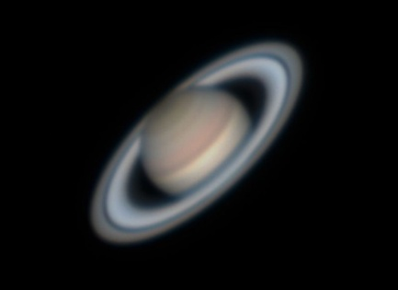
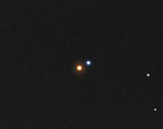
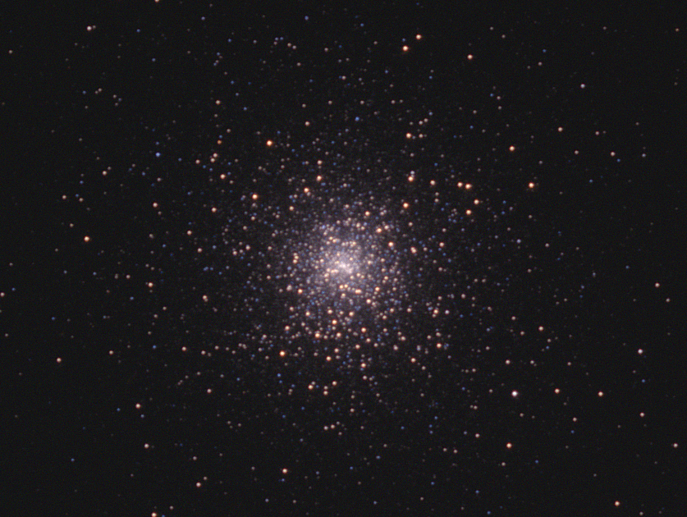
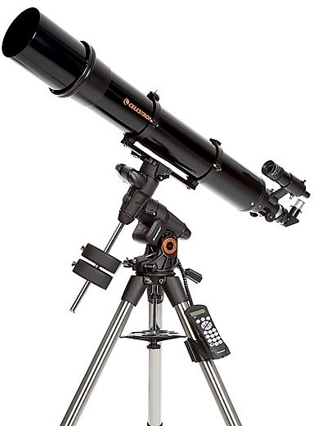
The Refractor
Excellent for small bright objects.
Planets
Double Stars
Clusters
Expensive.
Can be long and awkward to move and mount.
High magnifications need a very stable mount & drive.
Chromatic aberration. (Color - usual blue - halos)

Slide 9
The Refractor
Excellent for small bright objects.
Planets
Double Stars
Clusters
Expensive.
Can be long and awkward to move and mount.
High magnifications need a very stable mount & drive.
Chromatic aberration. (Color - usual blue - halos)

Slide 10
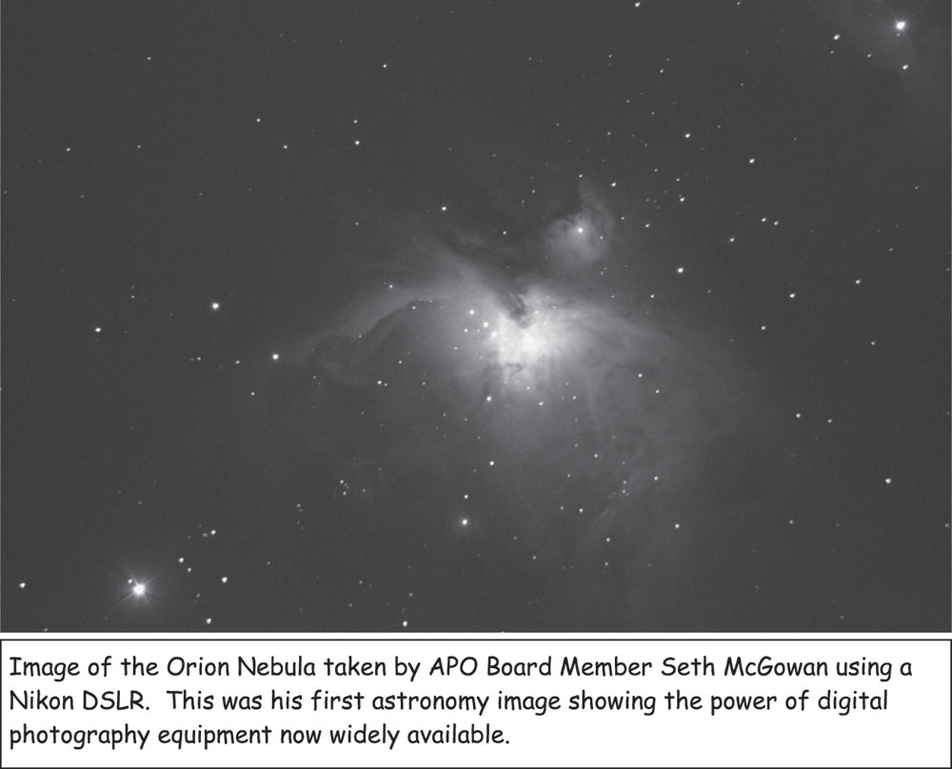
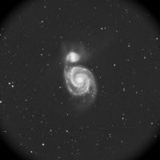
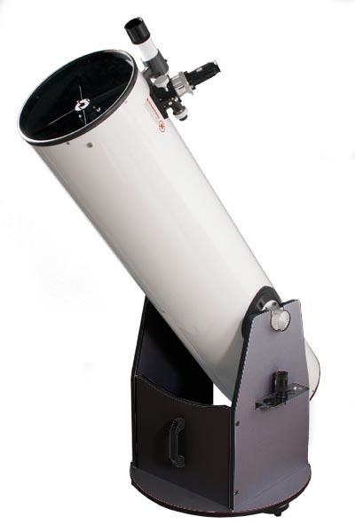
The Reflector
Often hear called Newtonian or Dobsonian.
Excellent for large faint objects.
Nebulae
Galaxies
Fairly inexpensive.
Dobsonian mount is very simple and stable but typically no drive or computer.
Finding objects can be frustrating at first but is a very good way to learn the sky.

Slide 11
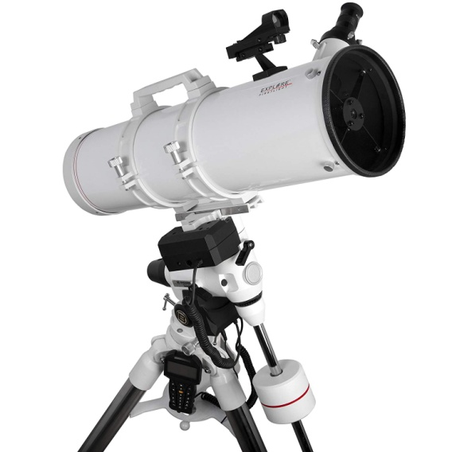
The Reflector
Often hear called Newtonian or Dobsonian.
Excellent for large faint objects.
Nebulae
Galaxies
Fairly inexpensive.
Dobsonian mount is very simple and stable but typically no drive or computer.
- Finding objects can be frustrating at first but is a very good way to learn the sky.
Reflector telescopes can also be mounted on high end computer driven mounts.
The secondary mirror "spider" mount creates diffraction spikes.
- Usually not objectionable.

Slide 12
The Reflector
Often hear called Newtonian or Dobsonian.
Excellent for large faint objects.
Nebulae
Galaxies
Fairly inexpensive.
Dobsonian mount is very simple and stable but typically no drive or computer.
- Finding objects can be frustrating at first but is a very good way to learn the sky.
Reflector telescopes can also be mounted on high end computer driven mounts.
The secondary mirror "spider" mount creates diffraction spikes.
- Usually not objectionable.

Slide 13
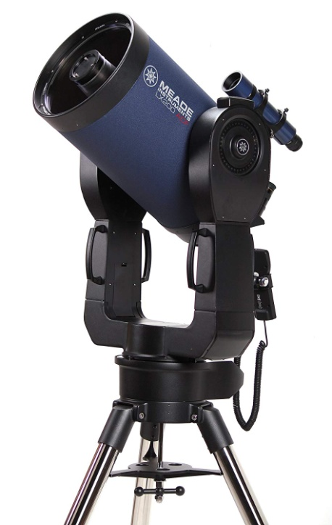
The Catadioptic
Often a Schmidt-Cassegrain Telescope or SCT
Good if not superb for most objects.
General purpose
Moderately expensive.
Very compact for their aperture.
Generally on good computer-controlled mounts.

Slide 14
Which is best?
It depends on what you want it to do:
 | Refractor | Reflector | Catadioptic
Planets | PPP | P | PP
Nebulae | P | PPP | PP
Galaxies | P | PPP | PP
Double Stars | PPP | P | PP
Affordability | P | PPP | PP
Portability | PP | P | PPP

Slide 15
How do I suggest to start?

Slide 16
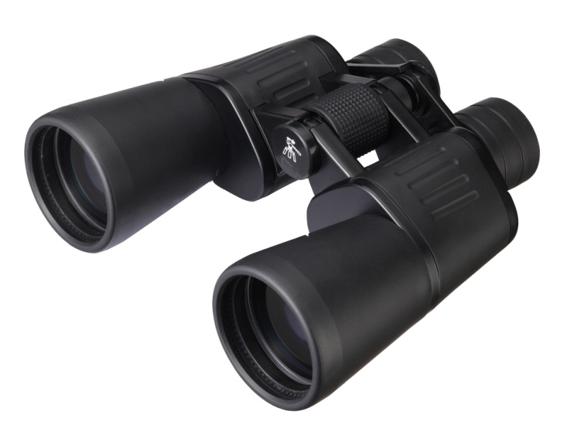
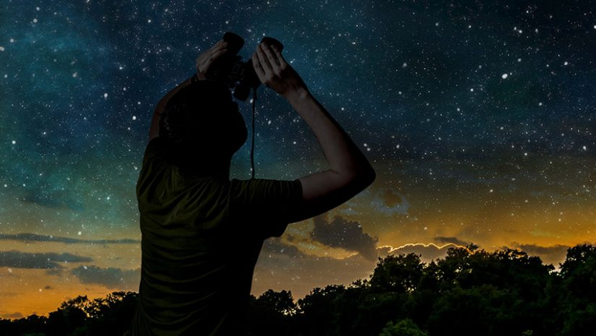
How do I suggest to start?
Start with binoculars!
Likely already have a pair.
A great way to become familiar with the sky and what you enjoy looking at.

Slide 17
How do I suggest to start?
Start with binoculars!
Likely already have a pair.
A great way to become familiar with the sky and what you enjoy looking at.
Join your local Astronomy Club.

Slide 18
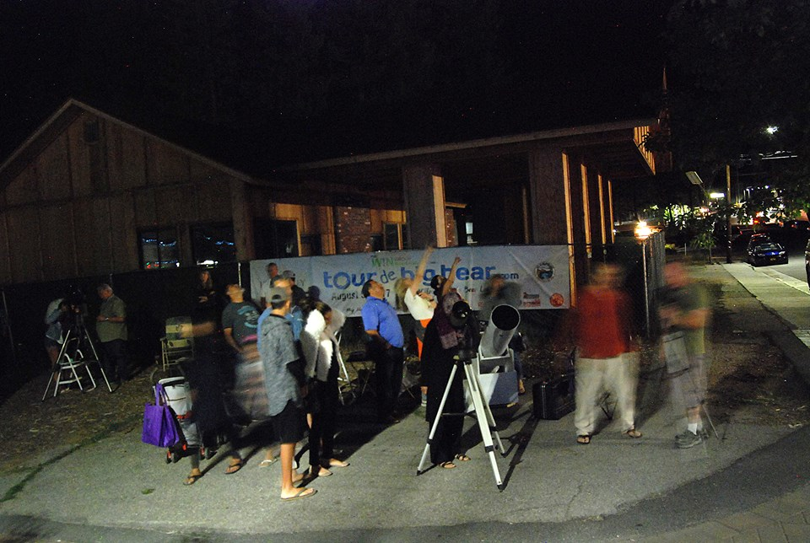
How do I suggest to start?
Start with binoculars!
Likely already have a pair.
A great way to become familiar with the sky and what you enjoy looking at.
Join your local Astronomy Club.
Attend a local star party and look through various different telescopes.
Most astronomers are very happy to have you look through their scopes and
discuss their merits and deficits.
Astronomy clubs often have "Loaner Scopes" available to try out.
Members often know of and can help check out used telescope which can
occasionally be had for very good prices.

Slide 19
How do I suggest to start?
Start with binoculars!
Likely already have a pair.
A great way to become familiar with the sky and what you enjoy looking at.
Join your local Astronomy Club.
Attend a local star party and look through various different telescopes.
Most astronomers are very happy to have you look through their scopes and
discuss their merits and deficits.
Astronomy clubs often have "Loaner Scopes" available to try out.
Members often know of and can help check out used telescope which can
occasionally be had for very good prices.
Don’t feel pressured to be in any hurry.

Slide 20
How do I suggest to start?
Start with binoculars!
Likely already have a pair.
A great way to become familiar with the sky and what you enjoy looking at.
Join your local Astronomy Club.
Attend a local star party and look through various different telescopes.
Most astronomers are very happy to have you look through their scopes and
discuss their merits and deficits.
Astronomy clubs often have "Loaner Scopes" available to try out.
Members often know of and can help check out used telescope which can
occasionally be had for very good prices.
Don’t feel pressured to be in any hurry.
And most importantly:

Slide 21
How do I suggest to start?
Start with binoculars!
Likely already have a pair.
A great way to become familiar with the sky and what you enjoy looking at.
Join your local Astronomy Club.
Attend a local star party and look through various different telescopes.
Most astronomers are very happy to have you look through their scopes and
discuss their merits and deficits.
Astronomy clubs often have "Loaner Scopes" available to try out.
Members often know of and can help check out used telescope which can
occasionally be had for very good prices.
Don’t feel pressured to be in any hurry.
And most importantly:
Have fun!

Slide 22
Thank you!

