Slide 1


Slide 2

MARS Exploration Grand Tour
MarS InterPLANETARY Parks by sr johnson

Slide 3
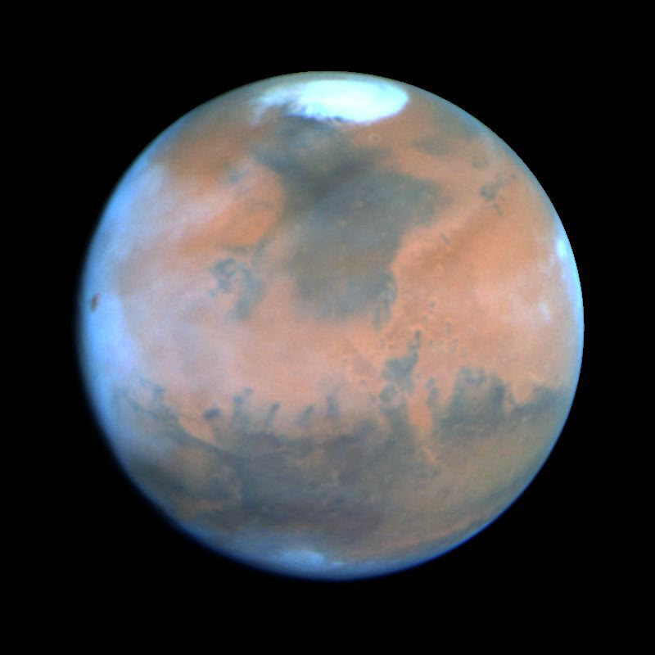
Hubble Telescope Picture of Mars
This NASA Hubble Space Telescope view provides the most detailed complete global coverage of Mars ever seen from Earth. This picture was taken on February 25, 1995, when Mars was at a distance of 65 million miles from earth.
Departing from Earth at 24,600 mph, it currently takes around 300 million miles and 7 months to reach the planet Mars. Leaving from a future Lunar Gateway Space Station may only take 4 months. Using the proposed Interplanetary Transport System, SpaceX predicts travel could be reduced to as few as 80 days.

Slide 4

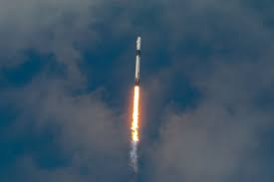
READY? HERE WE GO!
FIVE!
FOUR!
THREE!
TWO!
ONE!
AND WE HAVE LIFT OFF!

Slide 5
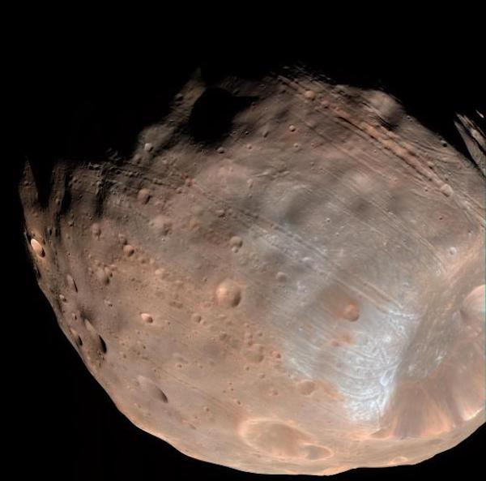
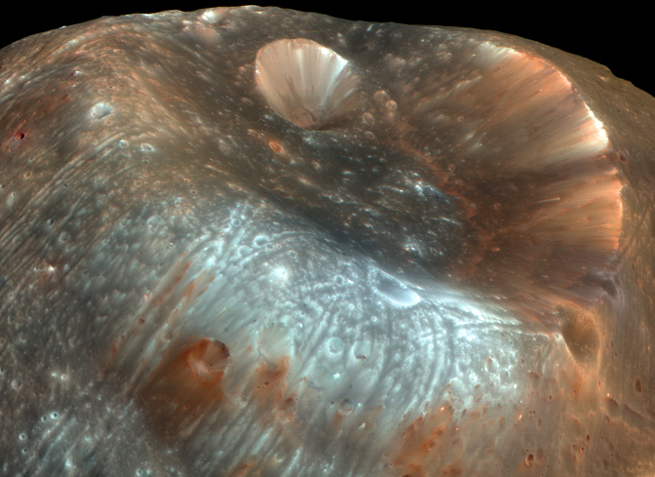

Our 1st Stop is the Mars “Gateway” Spaceport on Phobos
Phobos, like Earth's Moon, always presents the same face to the planet. Phobos is ~16 x 13 x 11 miles wide (about 3 times the size of Washington DC). Stickney crater on Phobos is 5.6 miles in diameter. The smaller crater inside is ~1.2 miles in diameter.
Due to orbit of Phobos, the Stickney Crater is shielded from direct solar radiation and cosmic rays 2/3 of the time. This could be a good location for a “gateway” spaceport to the surface of Mars.

Slide 6
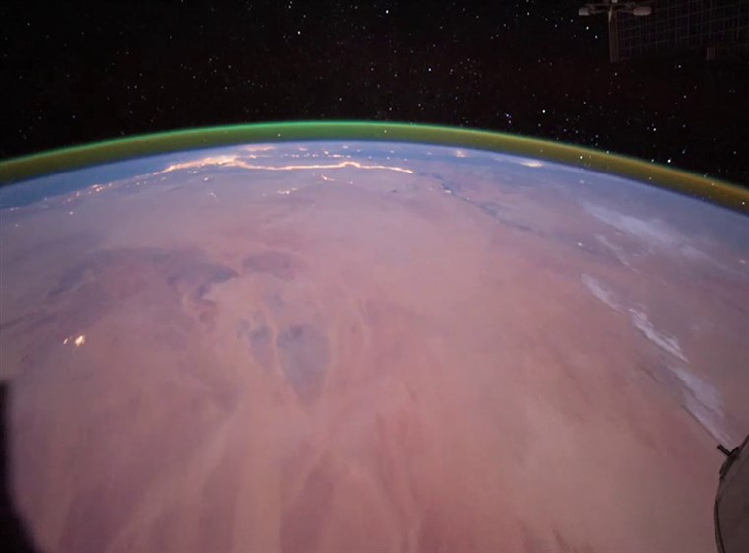
EMERALD AURORA aROUND mars
From the Phobos Gateway Spaceport, an emerald aurora high in Mars’ atmosphere could been viewed as observed by the European Space Agency’s Orbiter.
The glow is triggered by interactions between sunlight and oxygen molecules in the Martian atmosphere.
Then, it’s off to land at one of the spaceports on the surface and began exploring Mars!

Slide 7
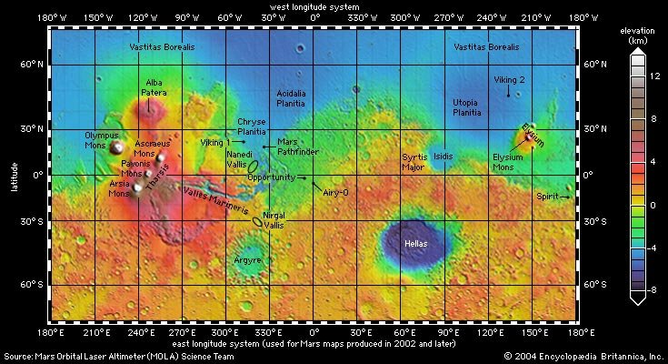
Acheron Spaceport
Deuteronilus Spaceport
GeographicCenter Geodetic Monument
Mars Prime Meridian

Slide 8
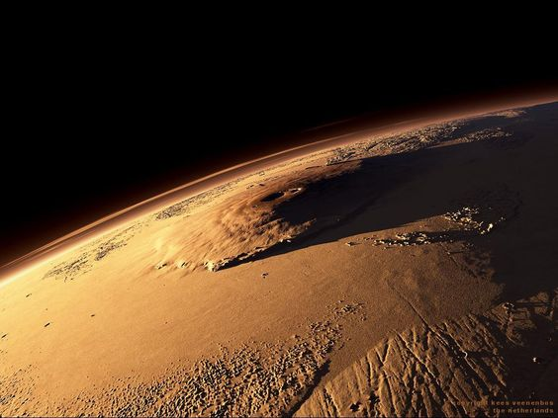
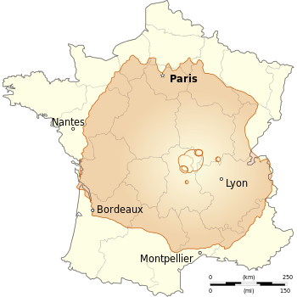
Olympus Mons
Tallest mountain in the Solar System
It’s 16 miles high from its base and 374 miles in diameter.
Olympus Mons is nearly as large as the country of France.

Slide 9
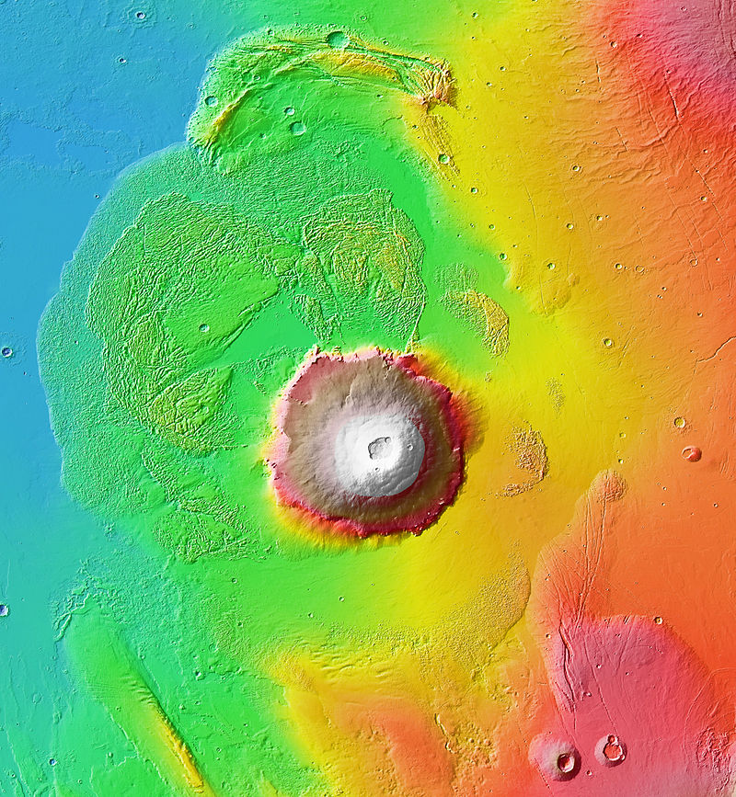
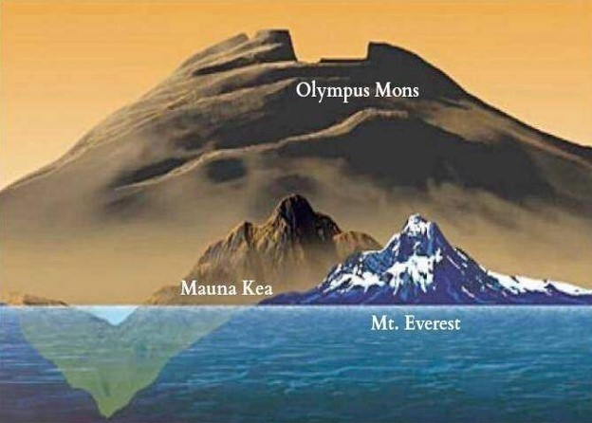
Olympus Mons is almost 3 times the height of Mt. Everest and more than 2 times the height of Mauna Kea, Hawaii.
It is so wide that if you were looking back from the edge of the great caldera, the base of the volcano would be beyond the horizon.

Slide 10
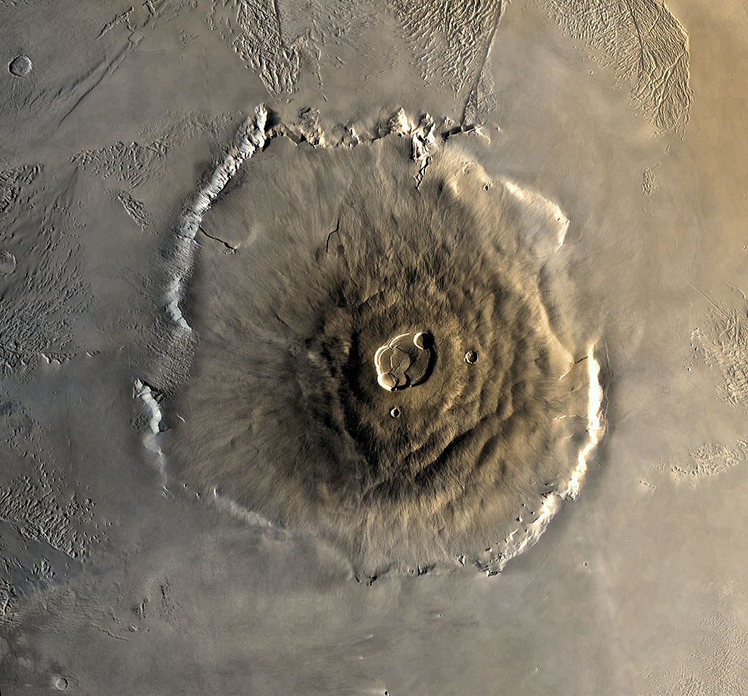
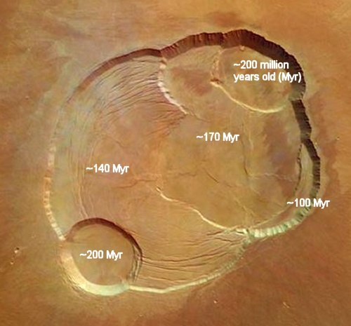
The caldera of Olympus Mons is larger than the famous Yellowstone caldera in Wyoming and roughly the size of the entire Yellowstone National Park.

Slide 11
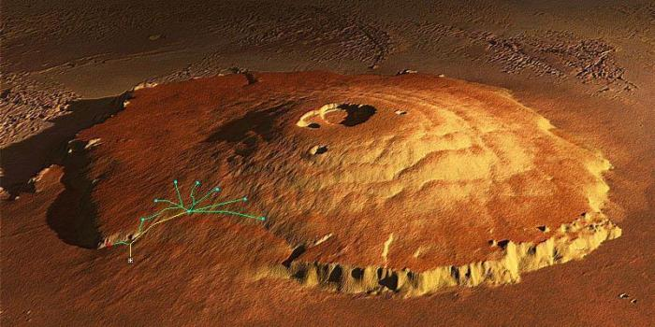

It’s 417 miles RT from base to top ~35 sols. Optional 4-mile rappel drop from the rim and ~9 sols RT to cross the 53-mile-wide caldera.
A 1,440-mile rover trip from Acheron Spaceport to a base camp at 40 mph would take ~4 sols.
Possible routes up to caldera from base camp at the bottom of the shield. In between the base and summit camps, approx. 15 solar powered hiking shelters would be needed about every 12 miles to provide heat, water and oxygen.

Slide 12
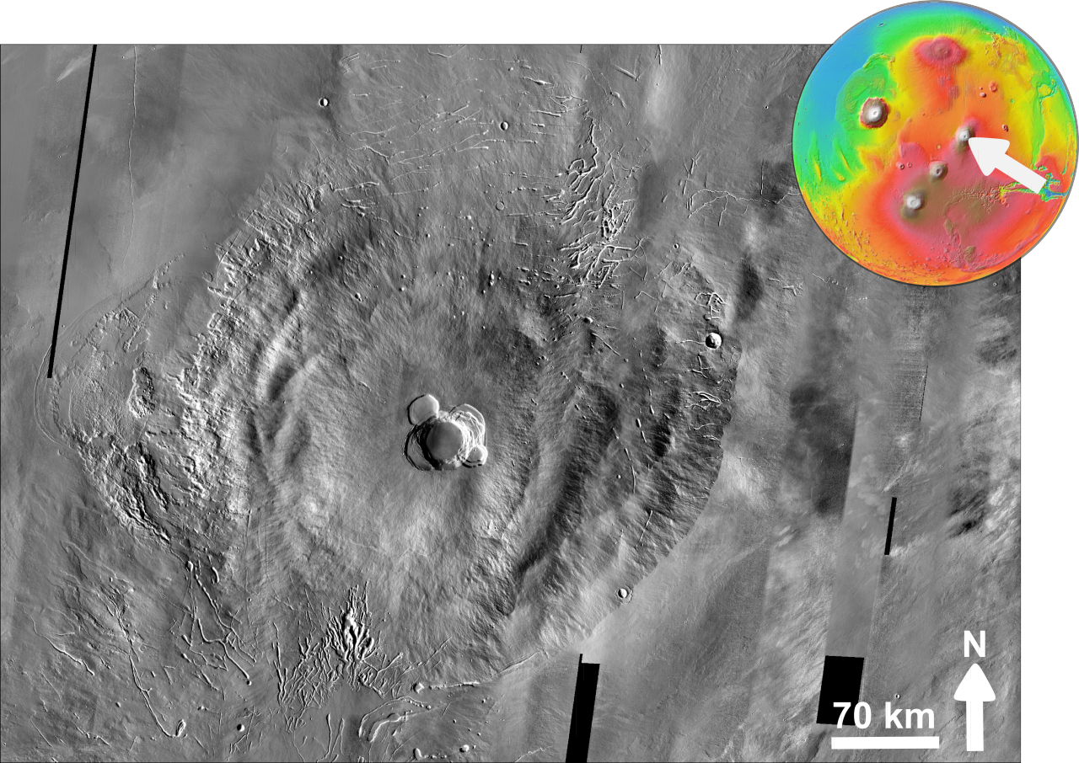
Tharsis Montes – Ascraeus Mons, Pavonis Mons and Arsia Mons -
A Triple Peak Ascent
Ascraeus Mons is roughly 300 miles in diameter and is the second highest mountain on Mars, with a summit elevation of 11.2 miles.
The volcano has a very low profile with an average flank slope of 7°. Slopes are steepest in the middle portion of the flanks, flattening out toward the base and near the top where a broad summit plateau and caldera complex are located.
Hiking ~300 miles RT to the top would take ~25 sols. Plus 2 sols RT travel from Pavonis Base.

Slide 13
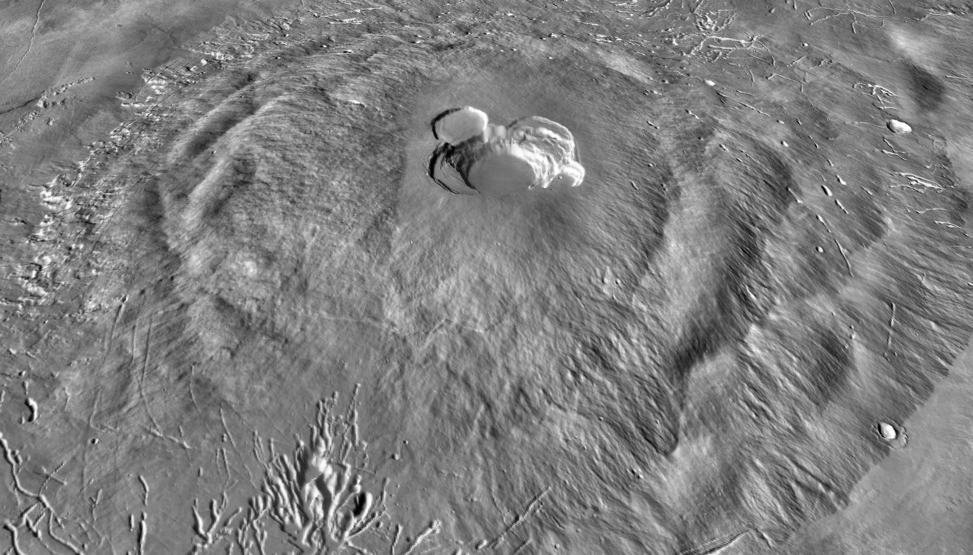

Slide 14
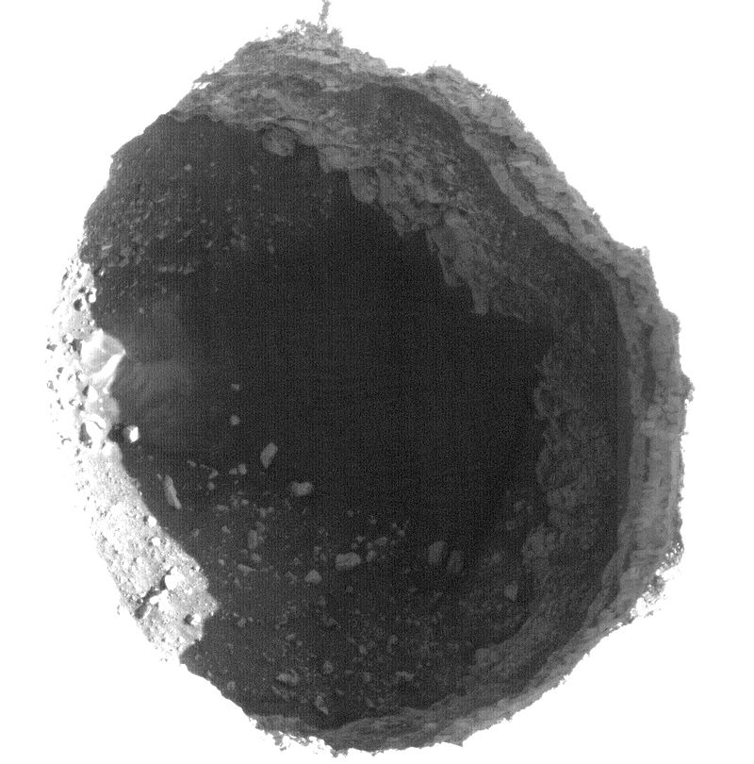
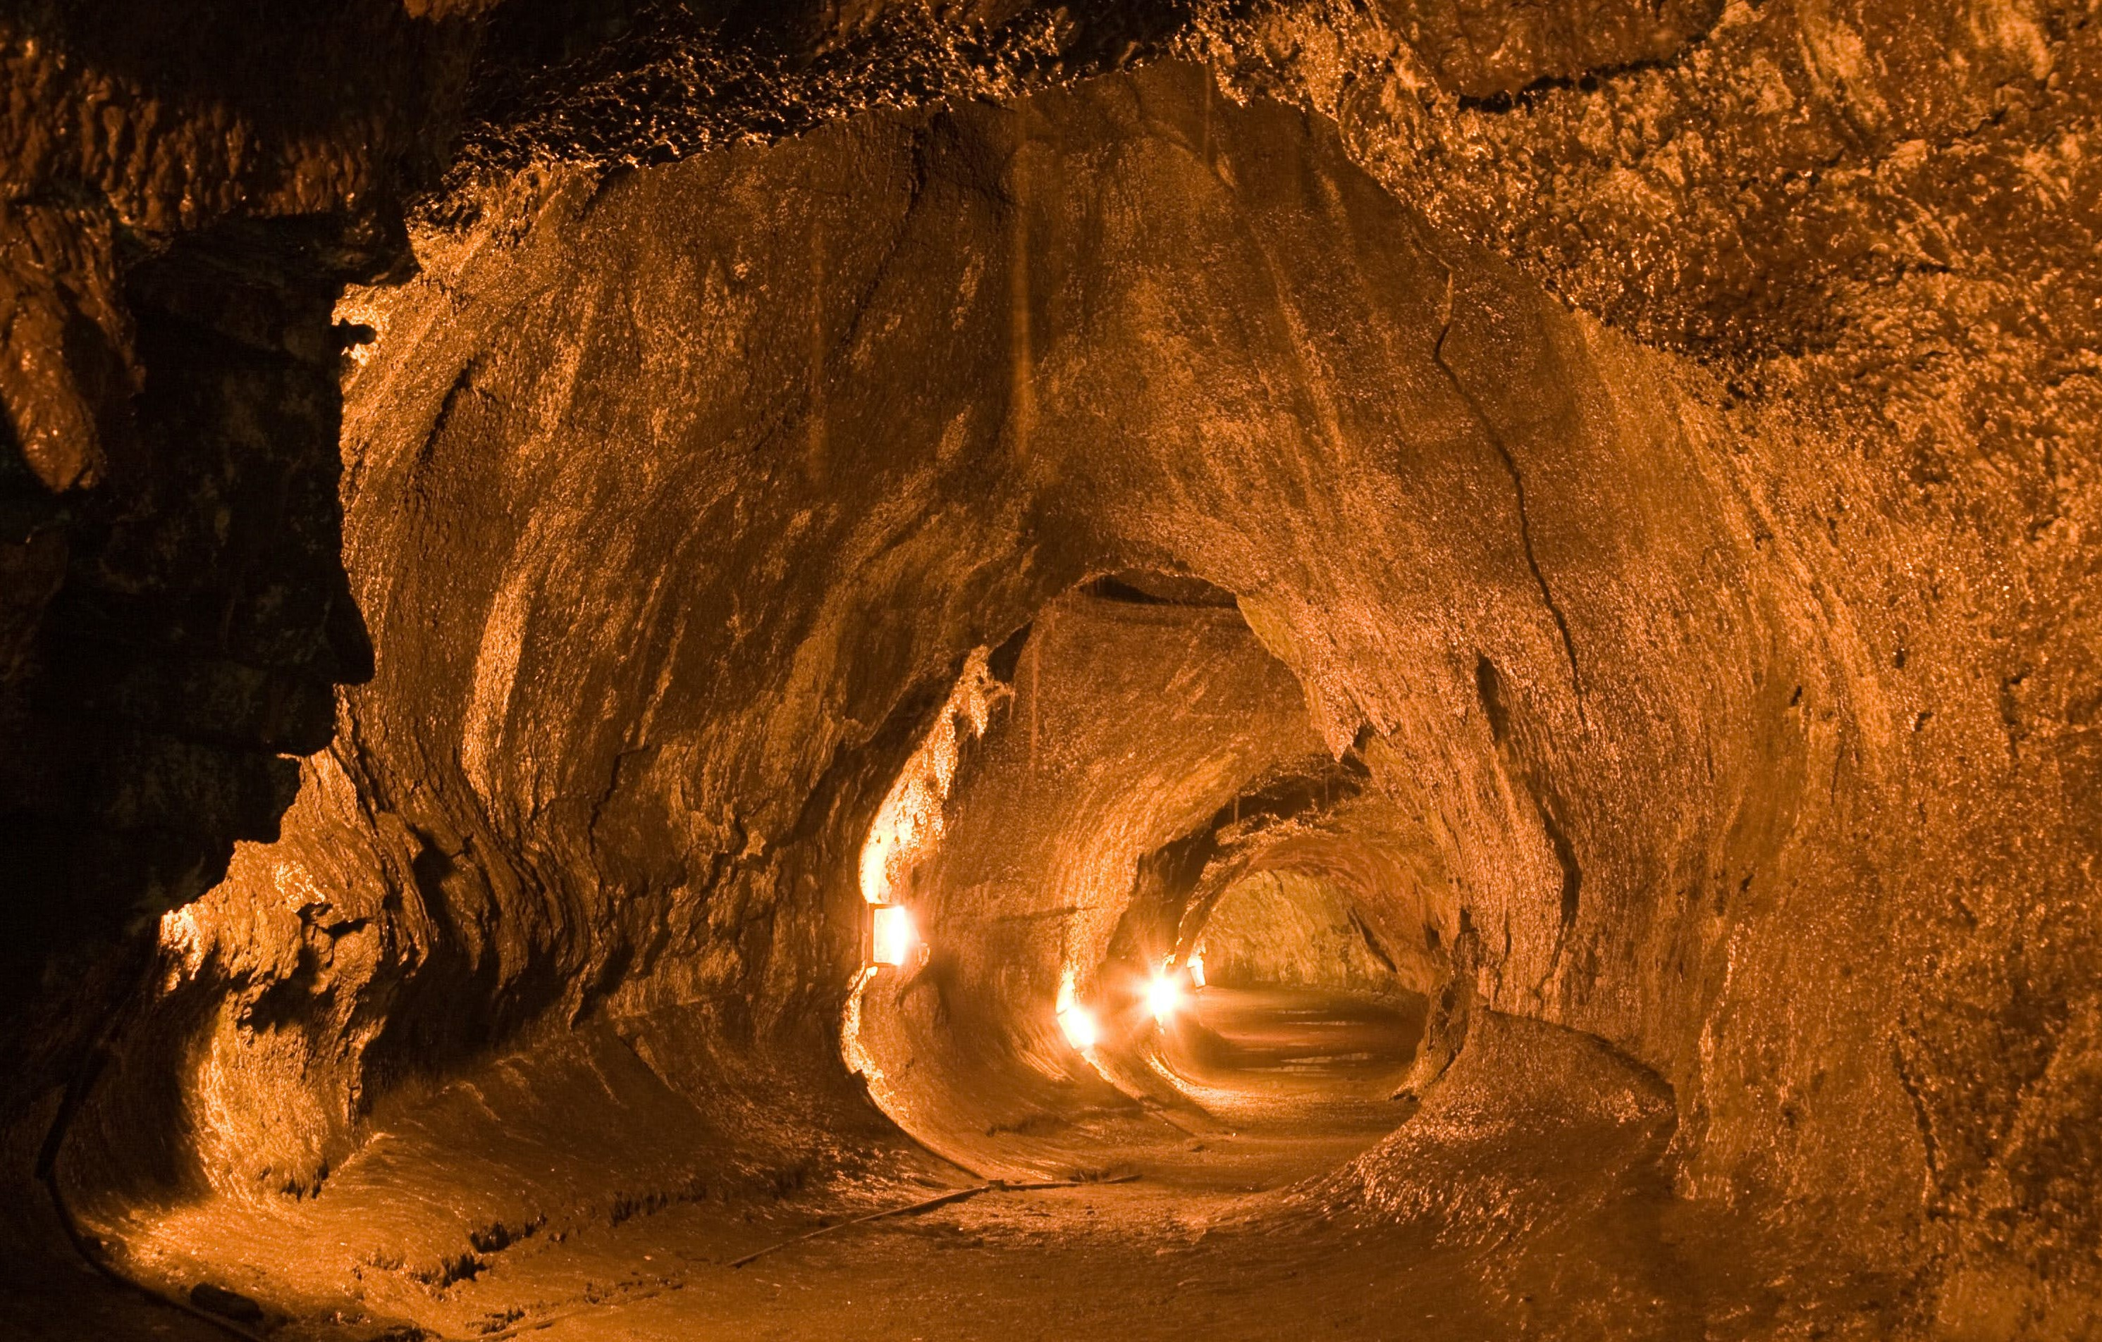
Spelunking - The lava plains northwest of Ascraeus Mons are notable for having two dark collapsed pits.
The two pits measure about 1,017 and 590 ft in diameter and the larger pit is approximately 590 feet deep. The eastern walls of the pits consist of steep, overhanging ledges. The bottoms of both pits contain sediments and large boulders.
These pit craters are believed to have formed by a collapse into a subsurface void created by a lava tube. They are similar to volcanic pit craters on Earth, such as the Devil's Throat crater on Kilauea Volcano, Hawaii.
In some cases, they may mark skylights or entrances to subsurface lava caves.

Slide 15
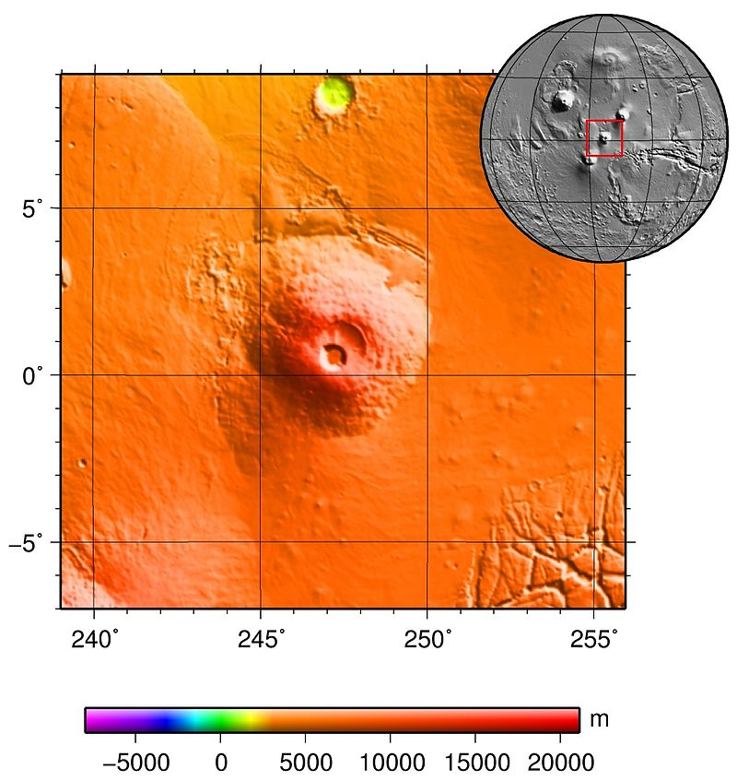

Pavonis Mons is the smallest of the Tharsis Montes volcanoes, measuring about 233 miles across and 6.4 miles above its base or 8.7 miles above the Martian “sea level.”
A shield volcano, Pavonis Mons has an extremely low profile with flank slopes that average only 4°. The summit contains a deep, circular caldera that is 29 miles in diameter and almost 3 miles deep.
Glaciers once existed on Pavonis Mons and may still to some extent. Evidence includes moraines "dropped" by glaciers, a knobby area (caused by ice sublimating), and a smooth section that flows over other deposits (debris-covered glacial ice).
A potential site for ice harvesting and geology science stations, a visitor center and aerial tram up to a remote telecommunications center on the peak. A high-speed tram would take about 3 hours RT at 75 mph. A “mule train” could ferry ice to the Acheron Spaceport ~1,430 miles or ~8 sols at 20 mph. By rover at 40 mph ~4 sols.
Hiking the Pavonis caldera would take 58 miles RT and 3-mile rappel/climb. ~5 sols..

Slide 16
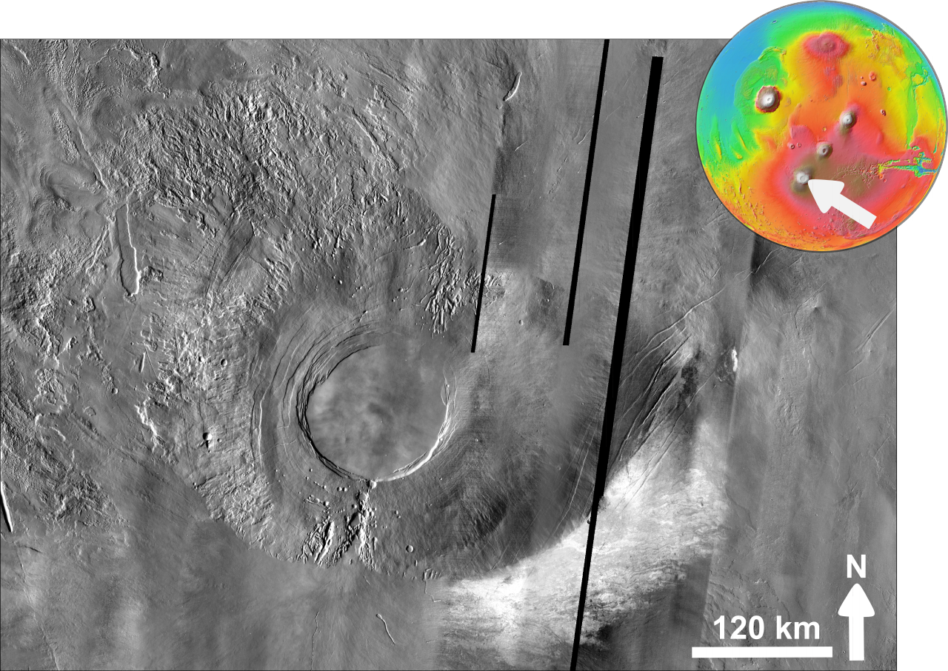
Arsia Mons is a shield volcano with a relatively low slope and a massive caldera at its summit.
The southernmost of the three Tharsis Montes volcanoes, the volcano is 270 miles in diameter, almost 10.7 miles high (7.6 miles higher than the surrounding plains). The summit caldera is 72 miles wide and was formed ~150 million years ago.
Next to Olympus Mons, it is the largest known volcano in terms of volume. Arsia Mons has 30 times the volume of Mauna Loa, Hawaii the largest volcano on the Earth.
Travel ~270 miles RT from a base camp to the top at 12 miles/sol would take ~23 sols. Plus 2 sols RT travel from Pavonis Base.

Slide 17
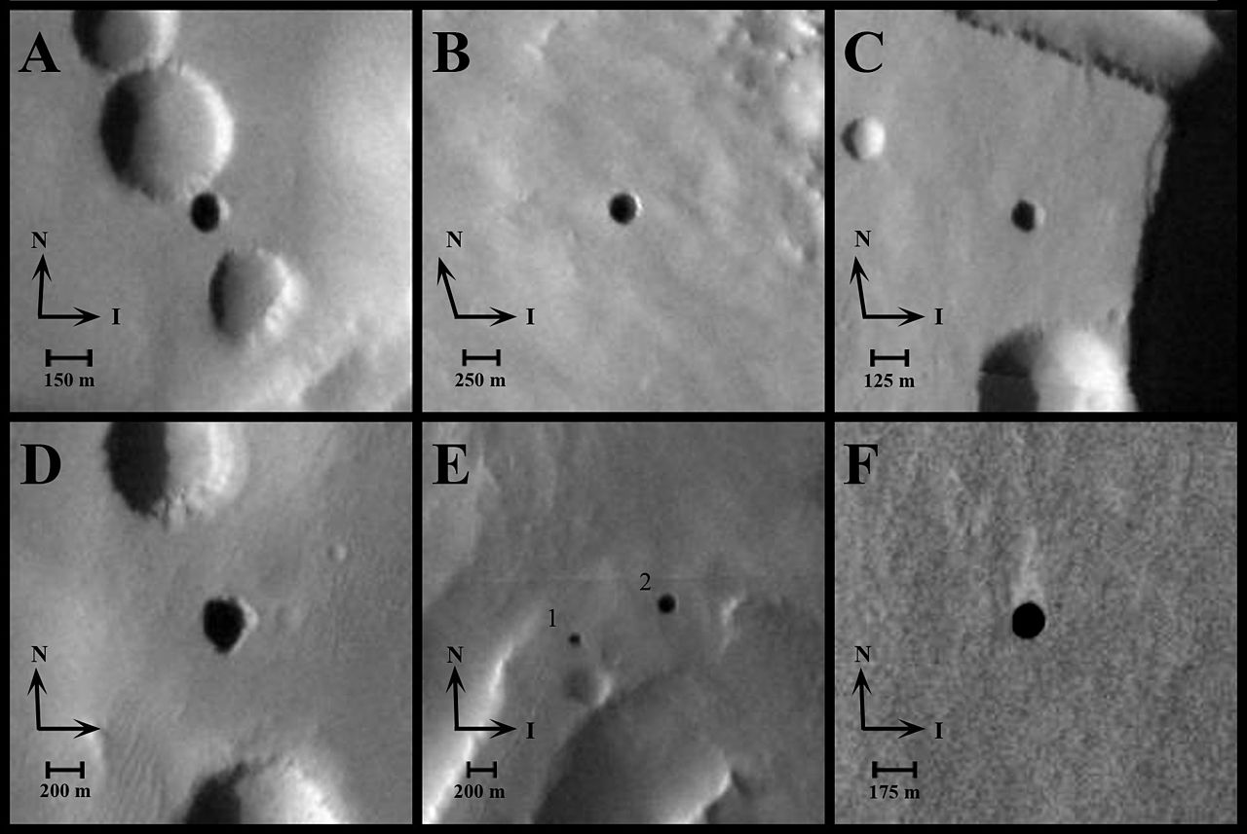
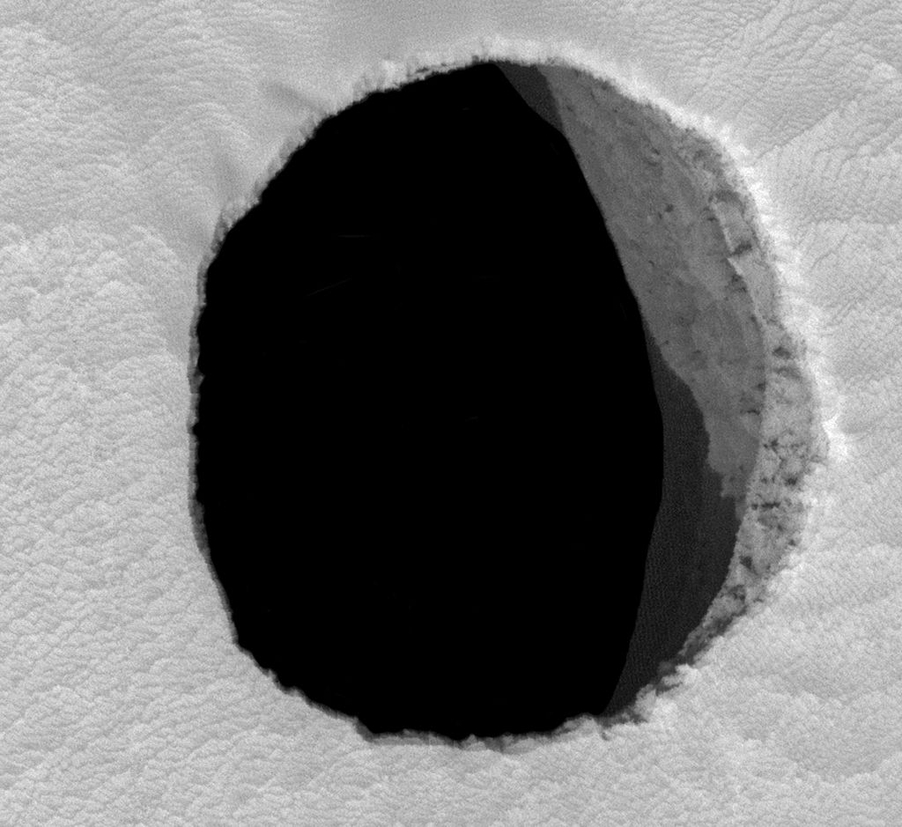
More Spelunking! - As of 2007, seven reputed cave entrances have been identified in satellite imagery of the flanks of Arsia Mons. They resemble "skylights" formed by the collapse of lava tube ceilings.
Cave entrance "Jeanne" on Arsia Mons
Spelunking trips to Arsia and Ascraeus Mons would take ~ 2 sols RT of travel and 2 sols for exploration. They would require a depot for spelunking equipment.

Slide 18
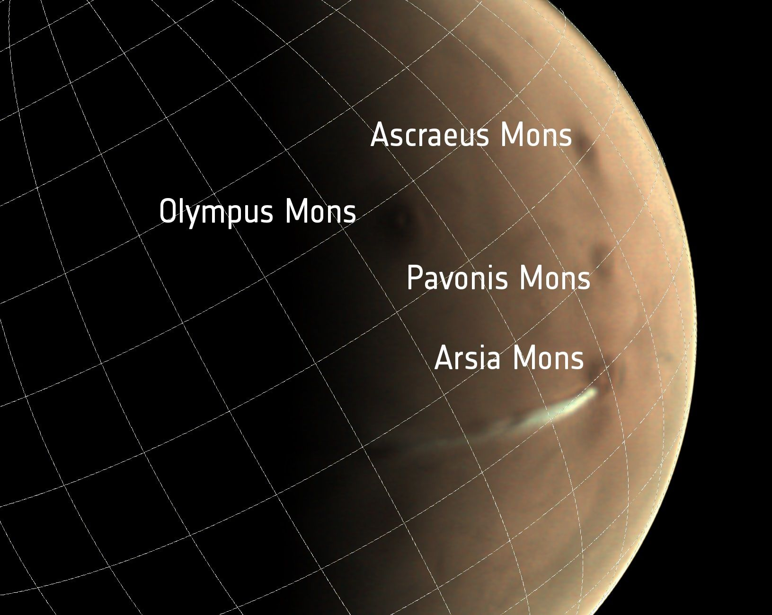
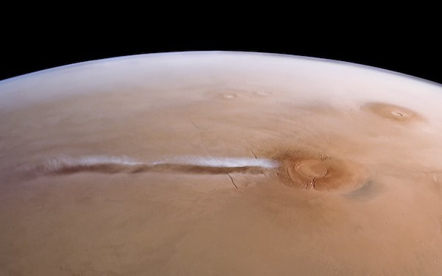
A strange cloud formation over 1,000 miles long can sometimes be seen in the skies above Arsia Mons.
Though it appears to come from the crater of the volcano, the 93-mile-wide cloud is not due to volcanic activity but is likely a water ice cloud.
The cloud appears during the summer in the southern hemisphere – when the volcano sees a large amount of daylight.
The plume was first observed in 2018. The mysterious Mars cloud expands for three hours in the early morning and disappears a few hours later.

Slide 19
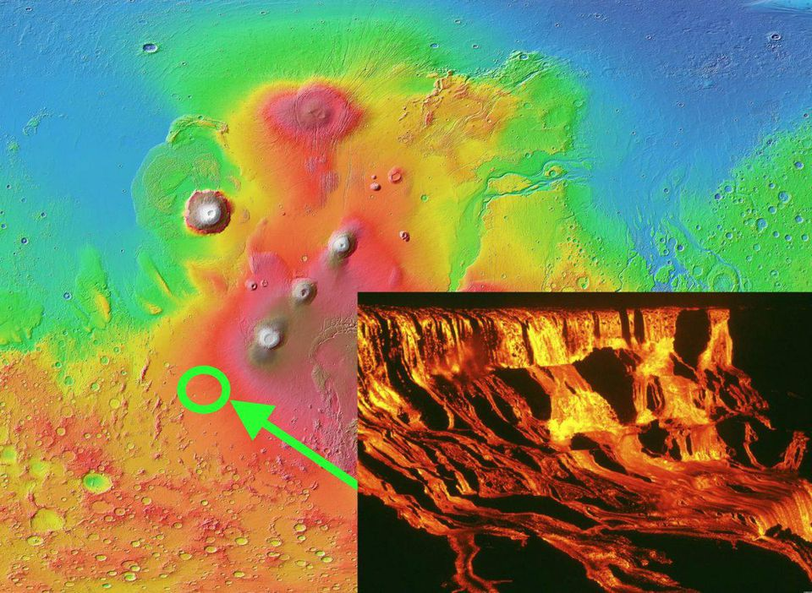
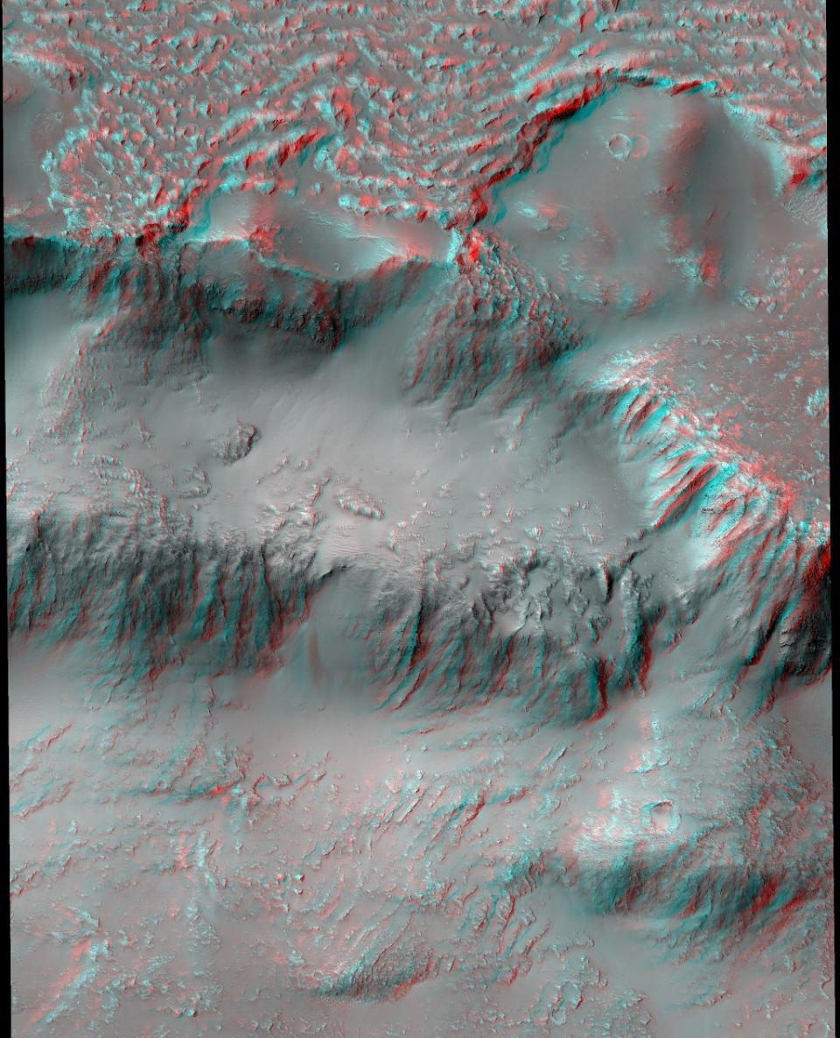
'Lava Falls’ Monument
A 19-mile-wide crater in the western portion of the Tharsis volcanic province shows multi-level lava cascades down crater walls and terraces toward the crater floor.
As the lava flowed to the crater floor, it left distinct fan-shaped features on the slopes.
Travel from the Pavonis Base to the lava falls overlooks would take ~4 sols RT or 2 sols RT from Arsia Mons.

Slide 20
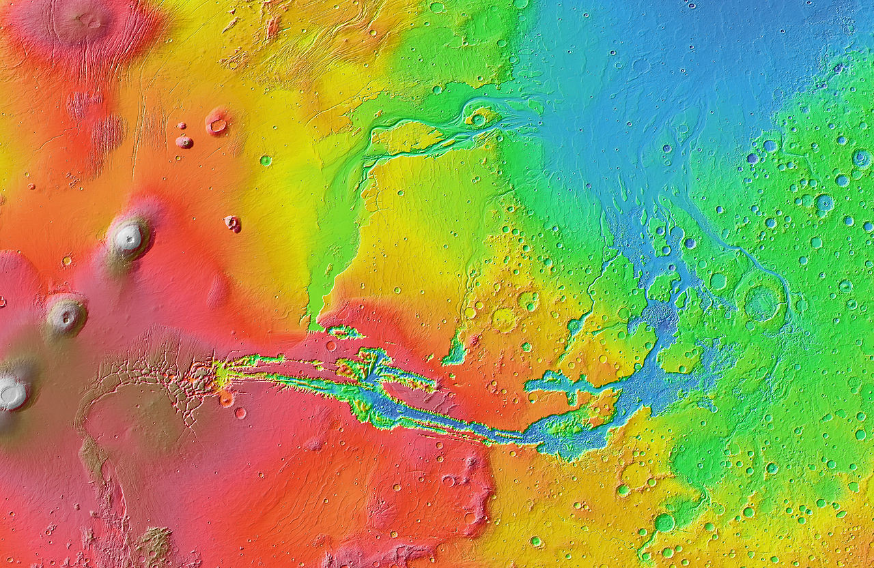
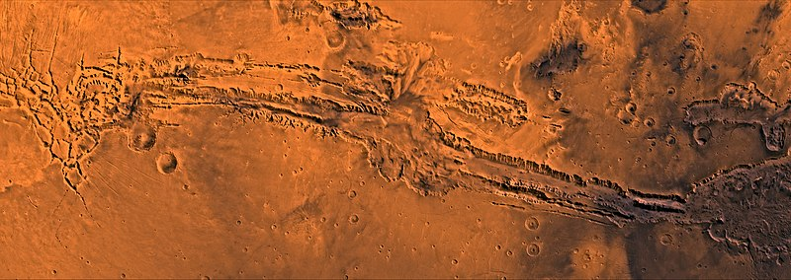
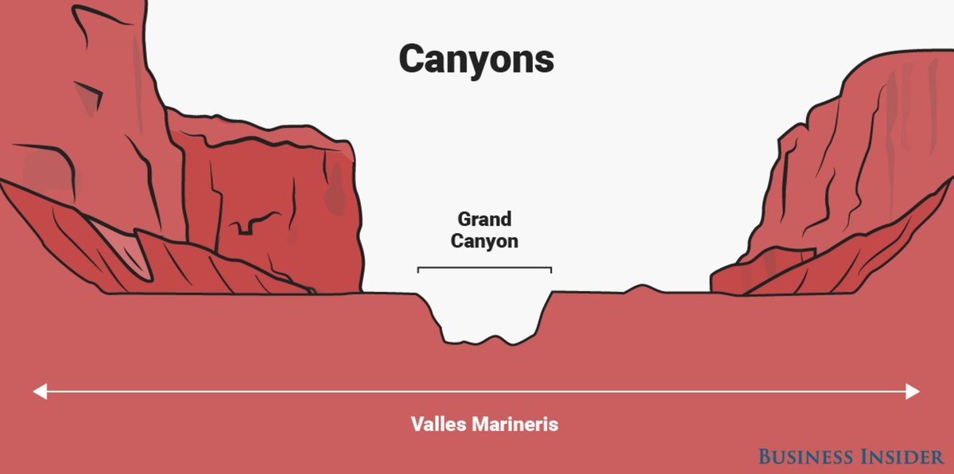
Valles Marineris – Mariner Valley
Longest and deepest canyon in the Solar System.
2,500 miles long and 373 miles across. It would take 5 hours RT to cross at 155 mph in a hydrogen powered balloon.
The north rim is ~1,600 miles from Pavonis Mons and travel at 40 mph would take ~4 sols.

Slide 21
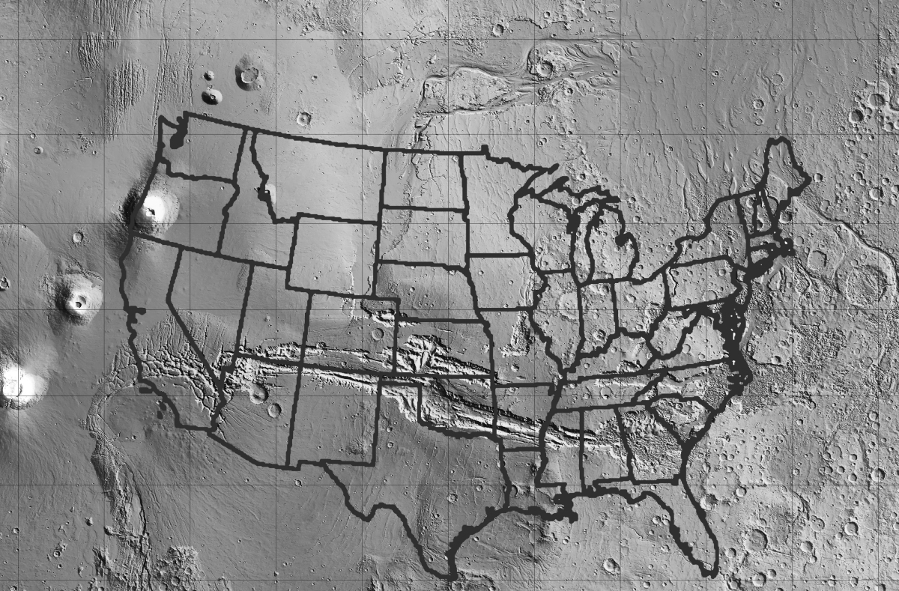
The Grand Canyon vs. Valles Marineris
Valles Marineris is as long as the United States and spans about 20% the entire distance around Mars
Notes:
21

Slide 22
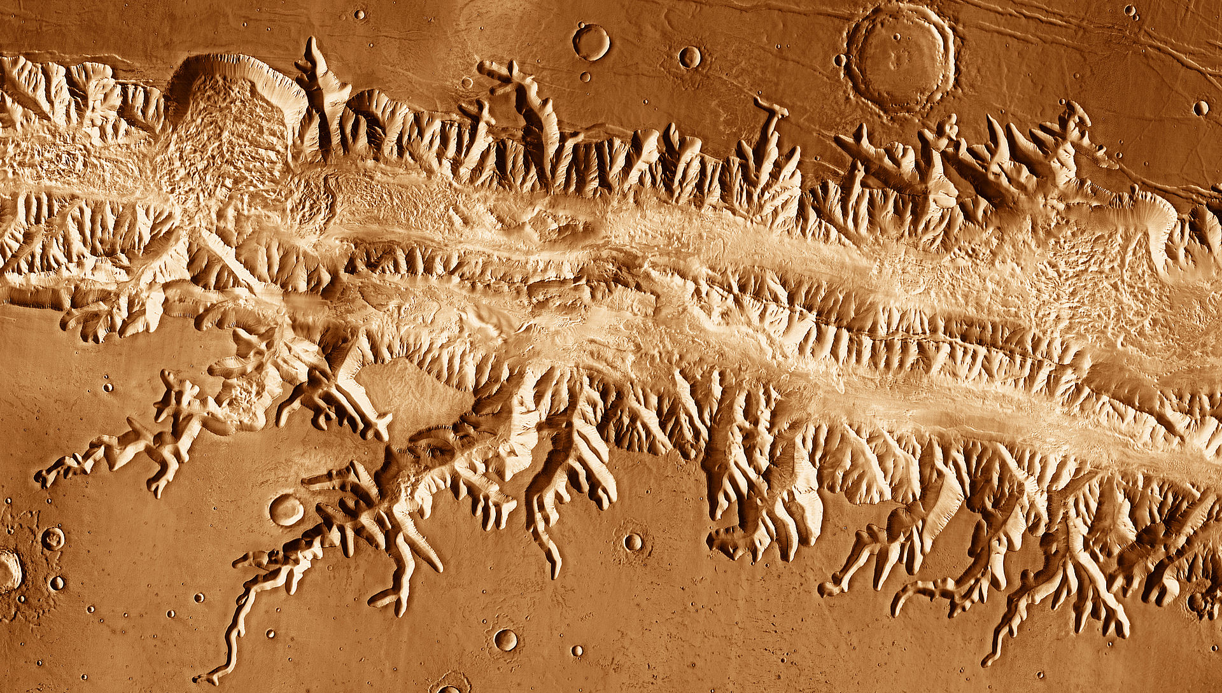
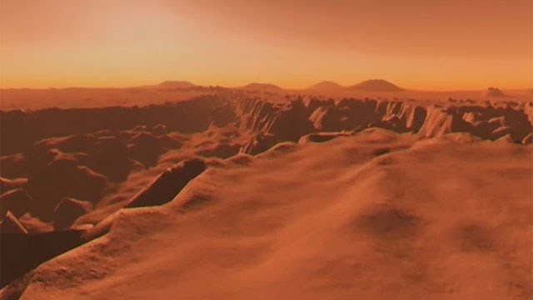
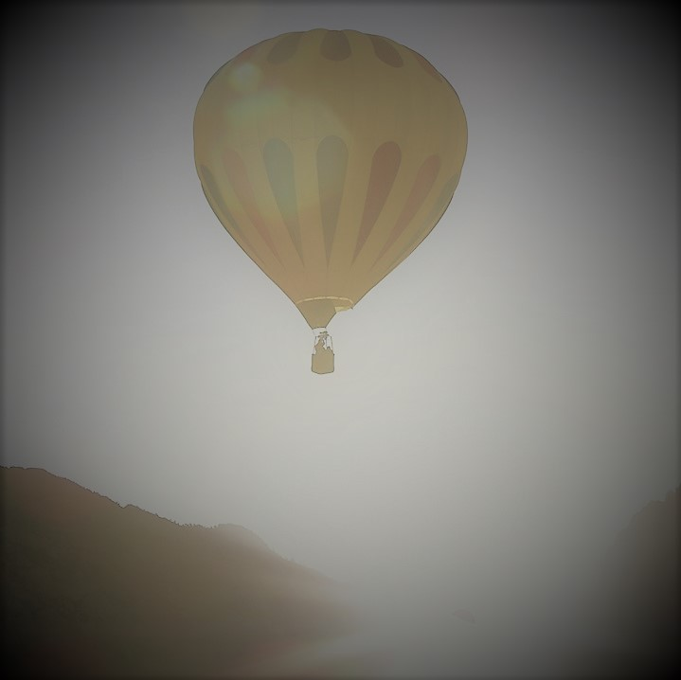

Slide 23
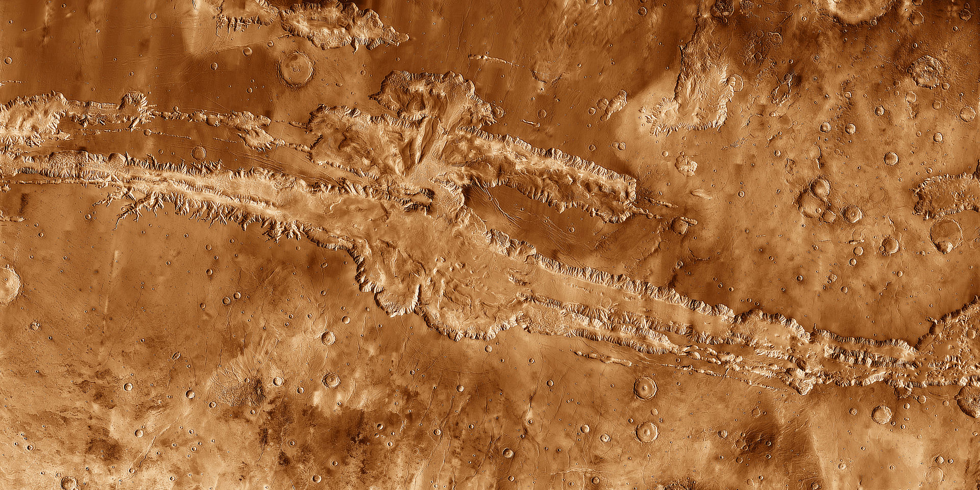
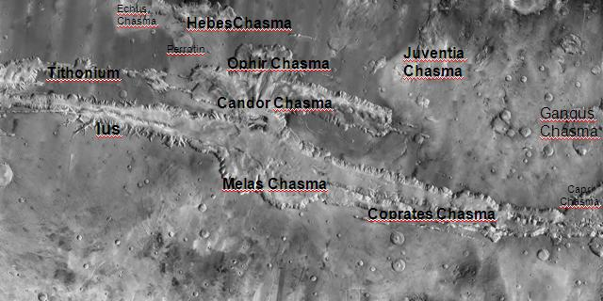
Valles Marineris - North Rim Itinerary
Stop at the Ophir Chasma and West Candor Chasma overlooks while traveling to the North Rim.
From a North Rim visitor center, take a tram to a geology science station 5 miles down at the bottom of Melas Chasma, ~10 minutes at 30 mph.
Take side trips by rover to the East Candor Chasma scenic overlooks.
Then travel to Juventae Chasma, an enormous box canyon 155 × 62 miles, with a low point of 3.7 miles below the surrounding plateau. Take a zip line across the chasm - each way taking 40 minutes at 155 mph.
HOLD ON TIGHT!
Travel by rover to the Hebes Chasma overlooks and to the Echus Chasma cliff climbing and bungee station.

Slide 24
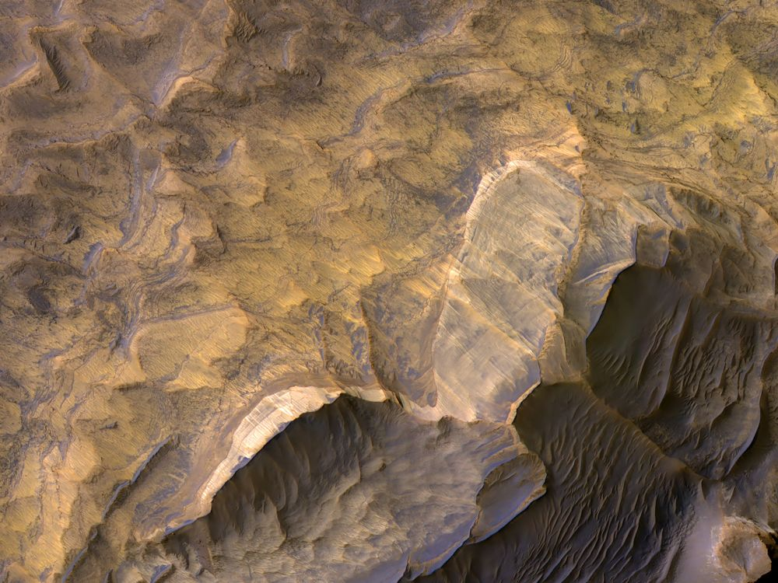
Sandstone Layers on Mars
Light-toned layered deposits thought to be sandstones are seen in the West Candor Chasma of Valles Marineris.
They may have formed in an ancient wet and a once potentially habitable environment.
Notes:
NASA/JPL/University of Arizona

Slide 25
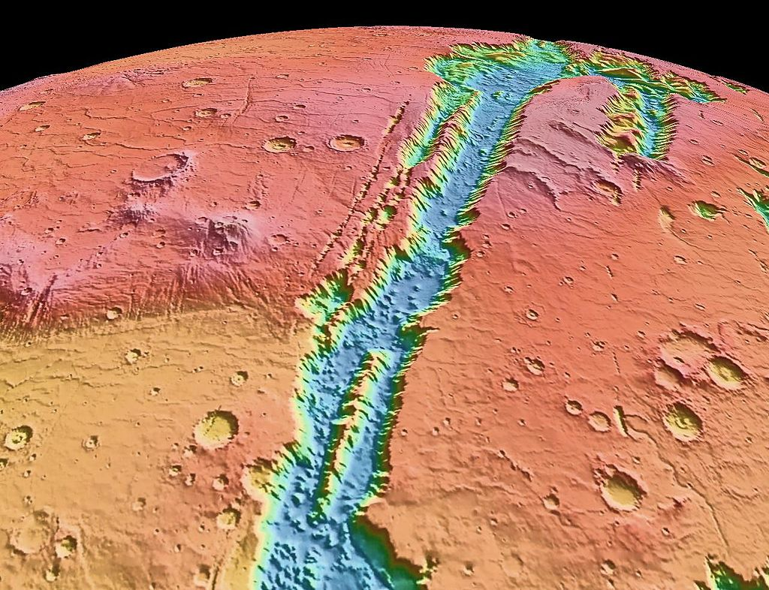

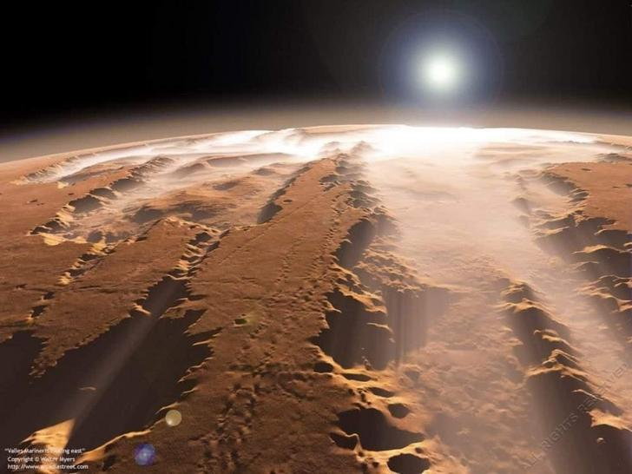
Looking west along the Valles Marineris to Coprates and Melas Chasmas and the Candor and Ophir Chasmas.
Water ice fog can form in the canyons in the early mornings.

Slide 26
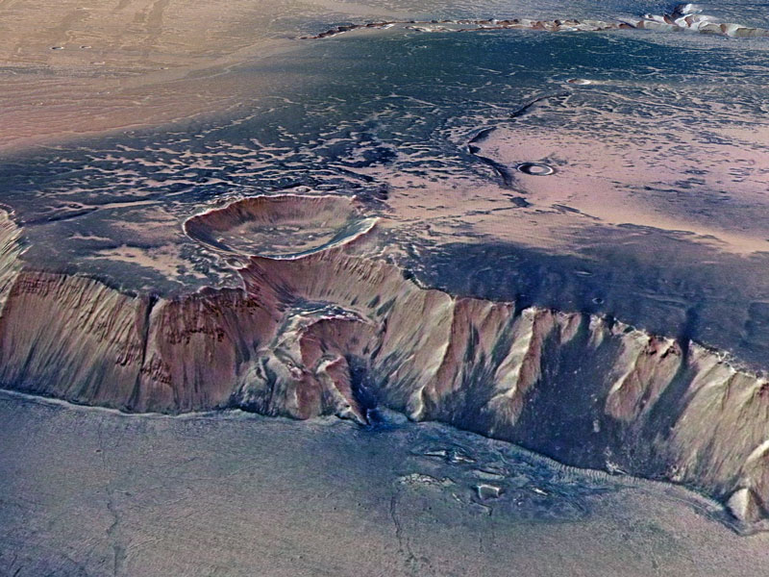

Echus Chasma –
Largest (ancient) waterfall in the Solar System
62 miles long, 6 miles wide and over 2 miles deep. Rappel down or bungee jump at 621 mph for 12 seconds. Then climb or take a cage elevator back up, or both!

Slide 27
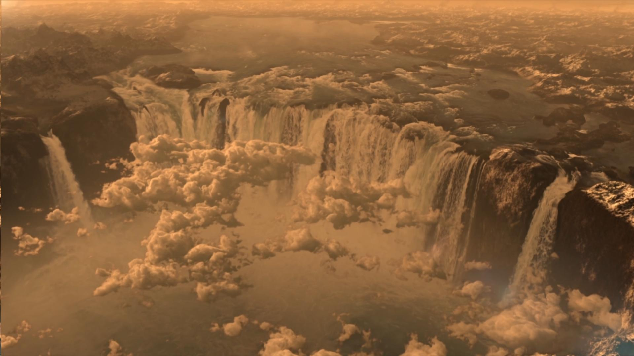
Artist rendering of Echus waterfalls during Hesperian Epoch (approx. 3 billion years ago - when life first began on Earth)

Slide 28
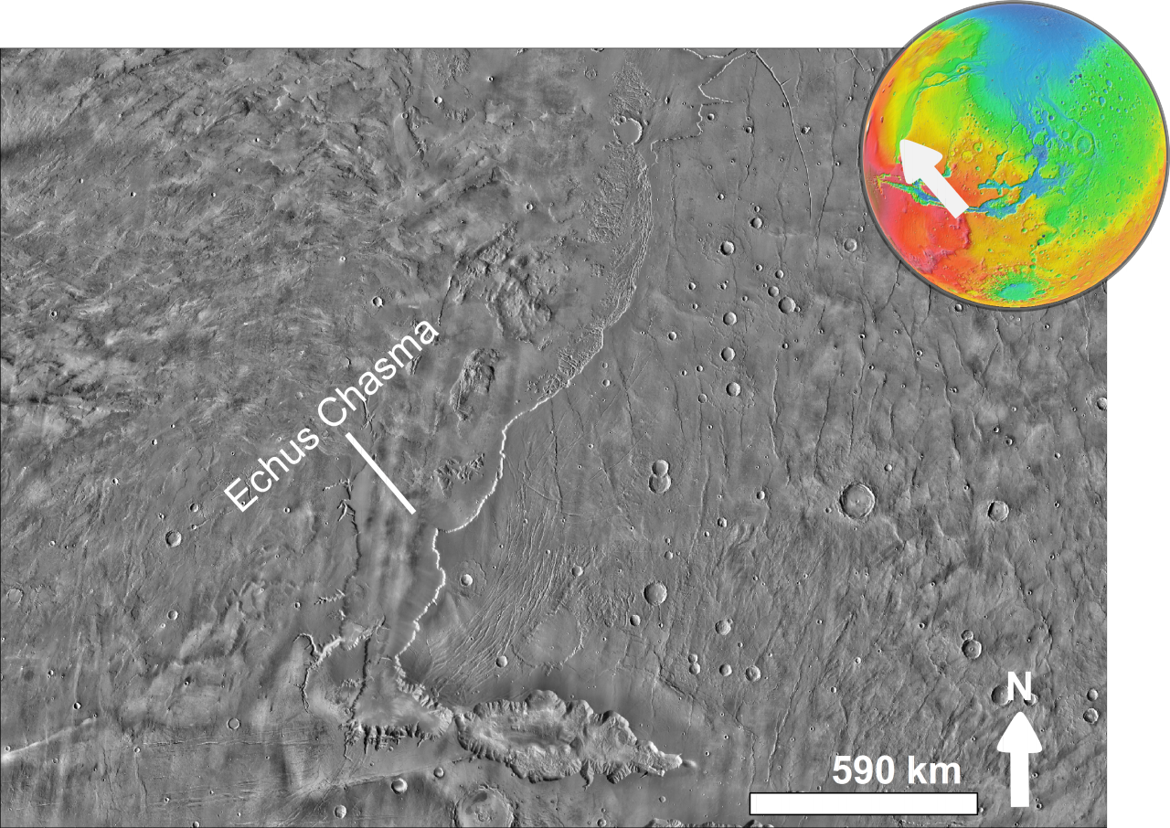
Echus Chasma Coordinates:1.0°N 278.0°E in Coprates quadrangle. West of Hebes Chasma.
It is the source of the Kasei Valles outflow channel extending to the Chryse Planitia.
Kasei Valles stretches ~1,730 miles west and south, nearly to the Valles Marineris. (About the distance from Los Angeles to Chicago). It is 300 miles wide in places (vs. the Grand Canyon at 18 miles)
It is one of the longest continuous outflow channel systems on Mars.

Slide 29
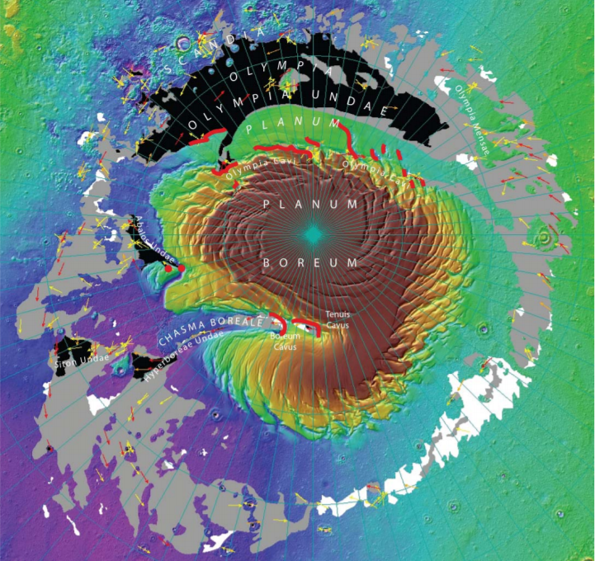
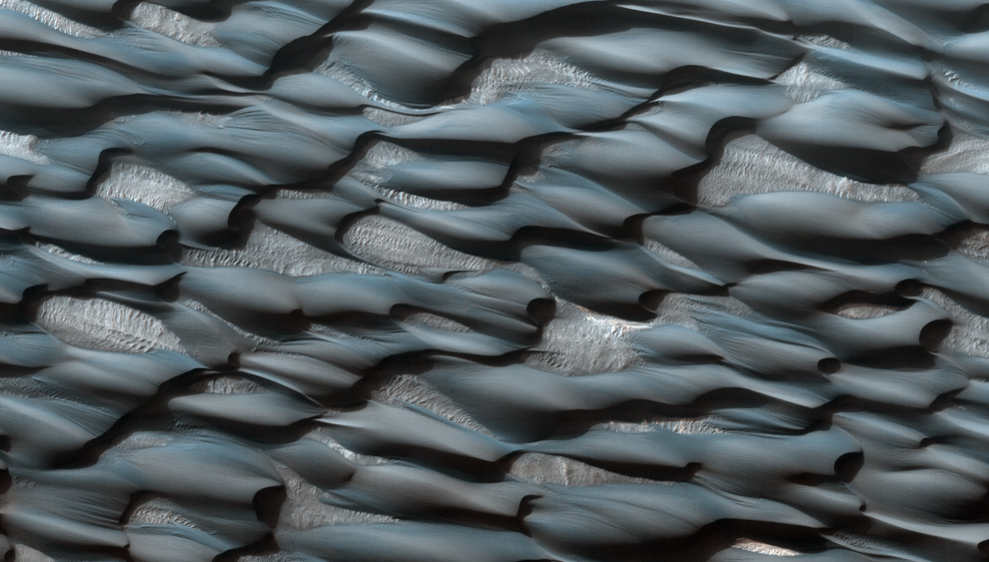
Planum Boreum Wilderness - Mars has the largest sand dunes in the Solar System
Abalos Undae is a dune field in the periphery of the Martian north pole. It is a smaller region at center left, between longitude 261°E and 283°E. The dunes appear bluish due to basalt sands.
Hyperboreae Undae is located southwest of the Chasma Boreale (a massive artic canyon). It is well known for its barchanoid and linear dunes.
Olympia Undae is a vast dune field in the north polar region. It consists of a broad "sand sea" that partly rings the north polar plateau from about 120° to 240°E longitude and 78° to 83°N latitude. Stretching about 680 miles across and covering an area of 181,468 sq miles (nearly the size of Nevada and Utah combined), it is the largest continuous dune field on Mars.
Siton Undae is one of the largest, densest dune fields in the vicinity of Planum Boreum. It is centered at latitude 75.55°N, longitude 297.28E and has a diameter of 138.6 miles.

Slide 30
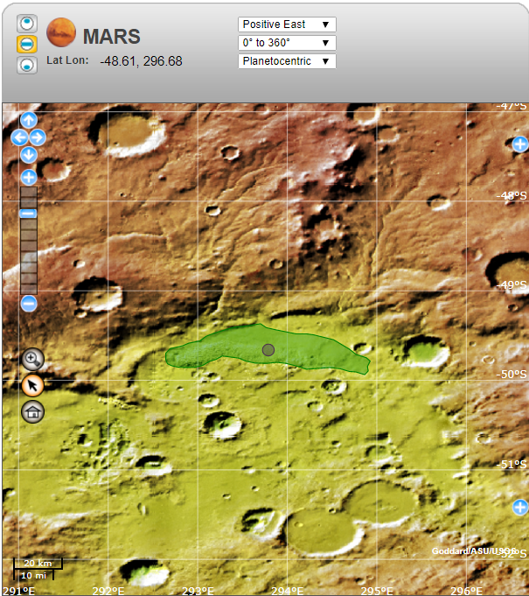
Ogygis Undae is the only named southern hemisphere dune field on Mars and the only major sand dune not located in a polar region.
Situated just outside Argyre Planitia - in the southern highlands of Mars - the dunes of Ogygis Undae cover an area of 735 square miles – more than 3 times the size of the Great Sand Dunes in Colorado. Ogygis Undae could be a primary location for research on Martian dune morphology and sand composition.
Dunes in Ogygis Undae include the barchan (crescent shaped), barchanoid (a ridge of interconnected crescent dunes), dome (large circular mounds of sand) and star dunes (symmetrical pyramid shaped sand mounds). Winds converging on the basin where these dunes are located carried sand there from many areas of Mars.
Travel to a dune science station at Ogygis Undae from the Pathfinder site ~3,200 miles at 40 mph would take ~8 sols. The total distance from the DC spaceport would be 5,400 miles or ~14 sols. Note: Possible bonus side trip up the 379-mile long Nirgal Vallis at 28.4° S and 42° W.

Slide 31
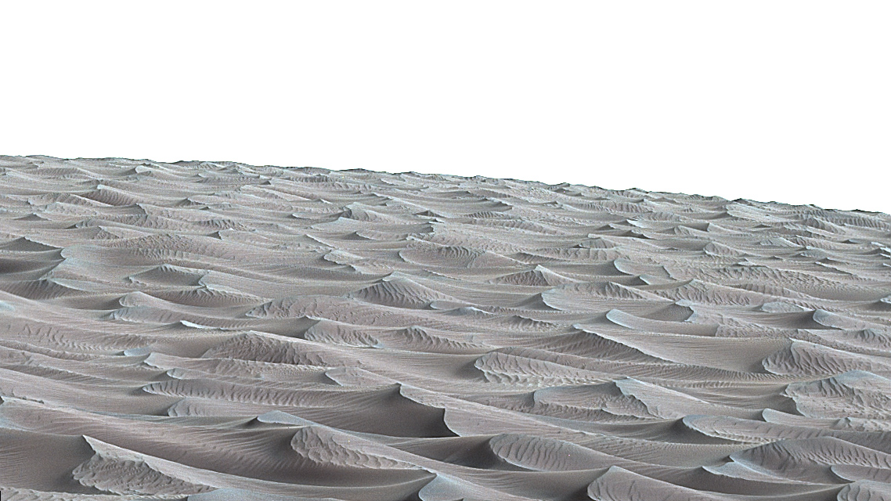
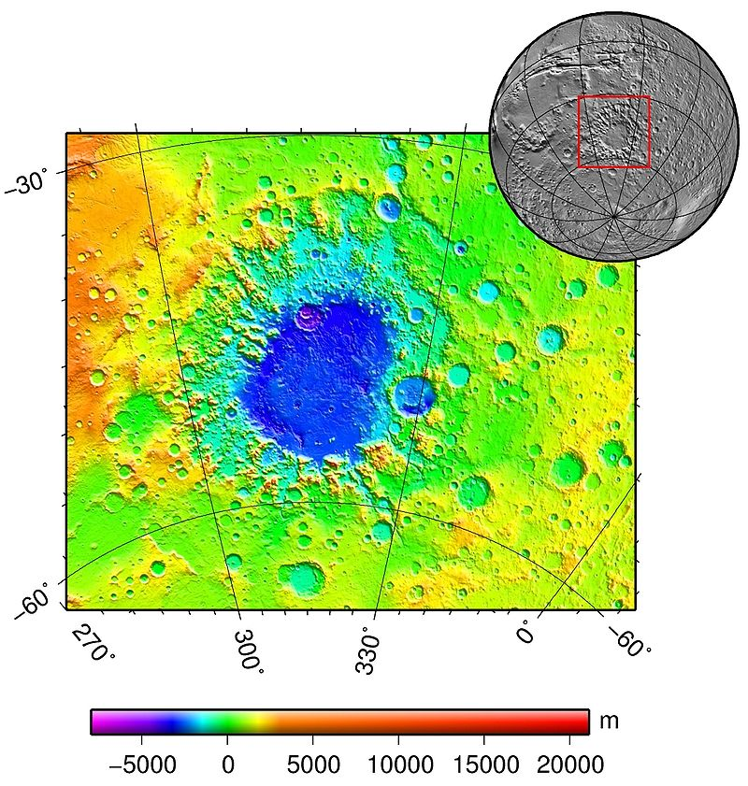
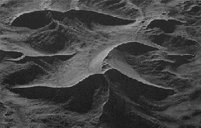
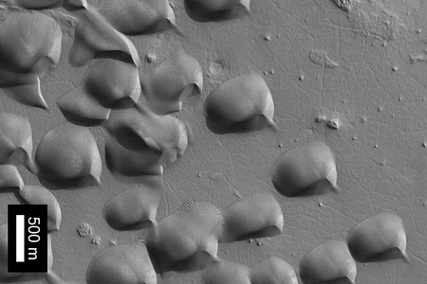
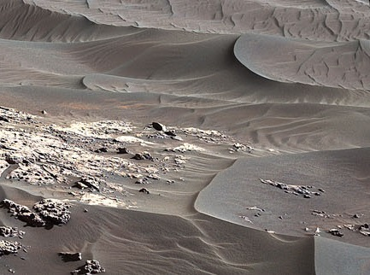
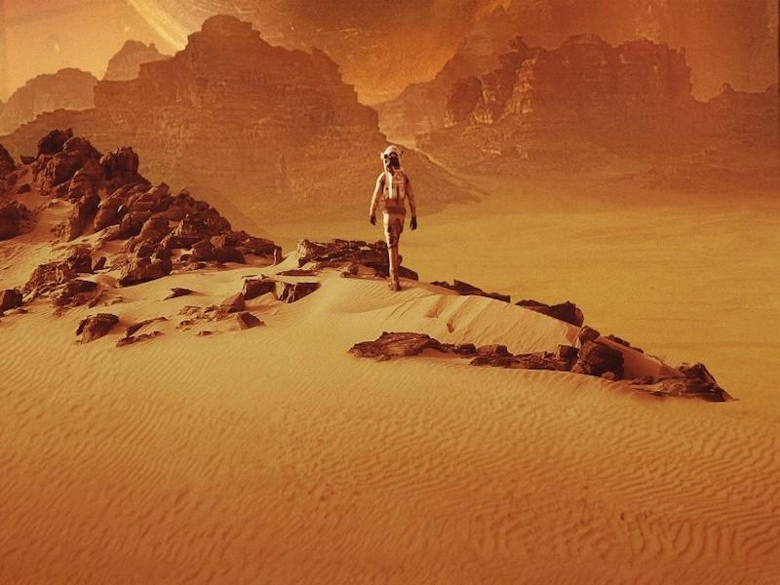
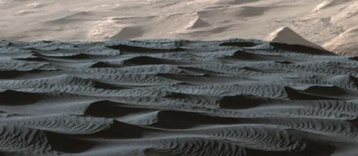
Argyre Planitia
Ogygis Undae

Slide 32


Lyot Crater Sand Dunes –
Lyot Crater is 147 miles in diameter and is the deepest crater in the Northern Hemisphere of Mars. It is located at 50.8° north latitude and 330.7° west longitude in the Ismenius Lacus quadrangle.
Lyot Crater is ~480 miles from the Deuteronilus Colles (DC) Spaceport ~12 hours at 40 mph.
Visit the “Blue Dunes” - Travel first by tram from a solar powered depot at the crater rim to the floor and solar powered ATV charging station ~50 miles to the blue dunes site or 4 hours RT at 25 mph (Note: Polaris RZR 1000 EPS top speed is 100 mph).
Cool!

Slide 33


The large, complex “blue dunes” are embedded within a field of classic, crescent-shaped dunes on the floor of the Lyot Crater, which lies about 50 degrees north of the Martian equator.
This particular dune, turquoise blue in enhanced color, is made of finer material and/or has a different composition than the surrounding sand.
(Note: The blue dunes are more likely grey in color.)

Slide 34


Black Dunes of Proctor Crater - a 104.5-mile diameter crater in the Noachis quadrangle of Mars, near the west edge of the Hellas Basin.
The crater contains a 22 x 40-mile dark dune field. These dunes are composed of basaltic ash and sand from ancient volcanic eruptions, collected in the bottom of the crater. and sculpted by the Martian winds. Ripple features reach almost 20 ft high and the dunes tower up to 300 feet.
Crossing the Hellas basin from the north rim would take ~2 sols. Proctor Crater is 480 miles from the western edge of the Hellas Basin or ~12 hours at 40 mph. From an ATV charging depot near the dune field, it would take 8 hours RT across the dunes at 25 mph. FUN, FUN, FUN!

Slide 35




Slide 36





Visit the Mars Interagency Lander/Rover (MILR) Museum at the Pathfinder landing site - where you can view all the landers and rovers on Mars recovered by the survey crews.
Travel to the Ares 3 junction from the DC Spaceport would take ~1,670 miles or
~4 sols at 40 mph.
Mars Trek 1.0 from the Ares 3 junction to MILR Museum is ~590 miles. At 40 mph it would take ~4 sols RT.

Slide 37





Mars interagency lander-rover museum
Top L-R:Mars 2 USSR 2 Nov 1971, Mars 3 USSR 3 Dec 1971 and Mars 6 USSR 3 Mar 1974.
Bottom L-R: Viking 1 USA July 1976-1983 and Viking 2 USA 3 Sep 1976-1980.

Slide 38




Mars interagency lander-rover museum
Clockwise:
Mars Pathfinder and Sojourner USA. 4 Jul 1997 to 27 Sep 1997
Mars Polar Lander /Deep Space 2 USA December 1999
Beagle 2 ESA 25 Dec 2003
Mars Exploration Rover Spirit USA 4 Jan 2004 to Mar 2010.

Slide 39




Mars interagency lander-rover museum
Top Right: Mars Exploration Rover Opportunity USA 25 Jan 2003 to 13 Feb 2019
Top Middle: Phoenix Mars Lander USA 25 May 2008 to May 2010
Right: Mars Science Laboratory/Curosity USA 5 Aug 2012 to present
Bottom Left: Schiaparelli ESA 19 Oct 2016

Slide 40



Mars interagency lander-rover museum
Left: InSight USA 26 Nov 2018 to present
Top Right: Perseverance/Ingenuity USA 18 Feb 2021 to present
Bottom Right -Tianwen-1/Zhurong China 15 May 2015 to present

Slide 41



Then take the “Mark Watney” Mars Trek 2.0 from the Ares 3 intersection to the Schiaparelli Crater – a 1,988 mile trip taking ~5 sols at 40 mph.

Slide 42



Schiaparelli Crater is 285 miles in diameter and is located near the planet's equator.
At right, is a close-up of the dune field in Schiaparelli.
Using solar battery charging depots near the crater center and western edge of the crater, drive electric 4WD Razor Dirt Quads around the 440-mile dune perimeter at 20 mph, taking ~ 2 sols.
Radical!

Slide 43



Slide 44


Korolev Crater –
Largest Known Ice Rink in the Solar System
Korolev is a water-ice filled crater near the north pole of Mars. The ice sheet is ~51 miles across and it contains about 530 cubic miles of ice, more than the volume of Lake Erie and Lake Ontario combined.
From a crater rim depot, take a tram 1.2 miles down to an ice sheet charging depot and a high-speed sled 4 hours RT across or 5 hours (159 miles) around the ice sheet at 30 mph.
Glide On!

Slide 45


Korolev Crater Is due north of the Elysium Mons promontory and south of the north polar ice cap. Above 70 degrees latitude, water ice concentrations exceed 25% almost everywhere and is ~ 100% at the poles.
This is a potential site for an ice harvesting station. A heavy-duty rover “mule” could transport ice wagons “trains” from Korolev Station to the Acheron and DC Spaceports for processing. It is ~2,052 miles to Acheron Spaceport (at 20 mph, ~10 sols) and ~4,583 miles to the DC Spaceport (at 20 mph, ~23 sols).
Along with supplies, the mule trains could carry personnel to an artic science station.

Slide 46

Hellas Planitia (Hellas Basin), like Death Valley in North America, is the lowest place on Mars
Hellas is the largest crater on Mars and the fourth-largest known impact crater in the Solar System. The basin floor is about 23,465 ft deep and extends about 1,400 mi east to west (approx. distance from Denver to Washington DC). The lowest point in Hella s Basin at -32.79° N 62.14° E is named “Badwater Crater” after Badwater Basin in Death Valley.
A giant lake may once have existed in the Hellas Basin. Possible shorelines have been observed. Large amounts of water ice may be located in the surrounding cliffs and in ancient glaciers in craters north of Hellas basin. This could be a potential site for an ice harvesting station.
The crater floor would also be a potential location for a geology science station. From the DC Spaceport to Dao Vallis (Death Valley) would be ~5,280 miles and at 40 mph would take ~13 sols. A 20-mph mule train from DC to an ice harvesting station would take ~ 24 sols.

Slide 47

Low Point in Hellas Basin
During winter in Hellas Crater, when the air is coldest and reaches its highest density, the air pressure is 103% higher.
This could allow a liquid phase of water under certain conditions of temperature, pressure, and dissolved salt content.
Some outflow channels extending into Hellas in the northeast are low enough for liquid water to exist around Martian noon when above freezing.
Apparent viscous flow features on the floor of Hellas Basin

Slide 48

Ancient Glaciers on Mars?
Glaciers below three craters in the Hellas region of Mars, now covered by rocky debris (left) and what they might look like if the ice was exposed (right).
Mars’ glaciers are frozen in place and covered by rocky debris for over 300 million years.
Boulders on the Martian glaciers are in distinct bands on the surfaces of the glaciers, indicating multiple ice ages over hundreds of millions of years.
Rocks and gases trapped inside these glaciers would be a place to search for fossils or other biomarkers of ancient microbes.
.
Notes:
image was created using image data from the Context Camera (CTX) on the Mars Reconnaissance Orbiter (MRO) spacecraft combined with results from the Shallow Radar (SHARAD) on MRO and High Resolution Stereo Camera digital elevation map from the Mars Express spacecraft. Image via NASA/ Caltech/ JPL/ UTA/ UA/ MSSS/ ESA/ DLR.

Slide 49



Lakes Below the South Pole of Mars?
Using radar, an underground saltwater lake about 18 miles across was recently found in the Ultimi Scopuli region of Planum Australe. In 2020, three adjacent smaller lakes were found, each measuring a few miles across.
Altogether these lakes cover an area of about 29,000 square miles or about the size of South Carolina. However, the brine is ~3,000 ft deep. A remote biology science station could explore these underground brine lakes once new drilling technologies are available.
The waters are likely hyper-saline perchlorate brines, known to form at Martian polar regions and which have survived for an extended period of time below freezing temperatures. It is possible that early Martian microbial life may also have survived in the briny lakes.
Using these lakes as potential water sources for the northern latitudes would be problematic, as they are opposite the Hellas and Argyre Basins and travel from the Acheron Spaceport would be quite lengthy and arduous over the heavily cratered Southern Highlands. The best access may be by shuttle from a Spaceport on Phobos.

Slide 50



VIEWS ON MARS
Image taken 25 May 2019 by the Curiosity rover showing sunlit clouds high in the Martian sky. Seen shining after sunset, these are noctilucent clouds, or night-shining clouds.
Dust particles scatter blue sunlight forward to create a blue halo of light around the setting Sun.
Night sky on Mars showing Phobos (right) and Deimos (left) as seen by Spirit Rover. Phobos orbits Mars 3 times a day and Deimos every 30 hrs.
Sunset on Mars

Slide 51


CLOUDS AND FOG ON MARS?
Patchy “clouds” on Mars as seen by the Mars Reconnaissance Orbiter. These clouds are too tenuous for rain to ever occur.
The clouds on Mars are likely formed from icy dust left behind by small meteors hitting the upper atmosphere or from water ice that sublimates from the north and south poles.
Fogs made of water ice can occur on Mars in the mornings, often filling valleys and craters.
Frosts of water ice have also been observed on the ground, condensing from the thin air at night.

Slide 52


Dust Devils on Mars
Mars Reconnaissance Orbiter spotted a Martian dust devil roughly 12-miles high in Amazonis Planitia on 14 March 2010. Scientists estimated that the plume was over 70 yards wide.
On Sol 2847, Curiosity viewed this dust devil in the Gale Crater
Dust devils are common on Mars, though they usually only whirl across the surface for a few minutes before dissipating. On average, on a given day, a small dust devil pops up every few acres across the Martian surface. They can leave visible tracks along the surface and are known to blow the Martian dust off solar panels.

Slide 53



Dust STORMS on Mars
Dust storms are a frequent feature on Mars, occurring in all seasons. Occasionally, they can balloon into regional storms in a matter of days and sometimes envelop the planet. These storms block the sunlight needed to recharge solar batteries.
Massive, planet-wide storms happen about once every three to four Mars years (six to eight Earth years). They can last weeks or even months.
Below right – a Martian dust storm April 2018 in Utopia Planitia.

Slide 54

View of Earth from Mars

Slide 55

Spaceport/Base
Ice Harvesting Station
Science Station
The Mars Grand Tour would take ~262 sols
Visitor Center
ATV Site
Travel Routes

Slide 56



SURFACE TRANSPORTATION
Eight 4-person KRUSTY-powered Mars Rovers would be needed, plus ten 2-person “Mini” Rovers for the science stations and survey crews. . They could be named after famous dogs (rovers)– e.g., Hooch, Marmaduke, Lassie, Marley, Scooby, Buddy, Buck, Benji, Toto, Hachi, Max, Dug, Bingo, Bolt, Odie, Astro, Charley and, of course, Snoopy.
Six 4-person KRUSTY-powered Mules would be needed. They could be named after famous mules - e.g., Gus, Francis, Jasper, Ruth, Conchita and Blue, or optionally just Jack (boy mule) and Molly (girl mule).

Slide 57
MARS EXPLORATION INFRASTRUCTURE

Slide 58

Potential spaceports and bases on Mars near subsurface water ice
Deuteronilus Spaceport and Mamers Base –
Deuteronilus Mensae contains glacier-filled lowlands southwest of Lyot Crater. Deuteronilus Mensae is a region on Mars 60 miles across and centered at 43.9°N 337.4°W. It covers 344°–325° West and 40°–48° North. The Deuteronilus region lies just to the north of Arabia Terra and is included in the Ismenius Lacus quadrangle. The region contains flat-topped knobby terrain that may have been formed by glaciers at some time in the past.
Deuteronilus Mensae is to the immediate west of Protonilus Mensae and Ismeniae Fossae. Glaciers persisted in the region in modern times, with at least one glacier estimated at forming as recently as 10,000 to 100,000 years ago. Recent evidence from the Mars Reconnaissance Orbiter has shown that parts of Deuteronilus Mensae do indeed contain ice.
A possible site for a spaceport would be Deuteronilus Colles (DC), adjacent to the southern end of Mamers Valles. A solar powered water, air and fuel conversion plant and greenhouse could be located near at a space base.

Slide 59




Red arrows = Protonilus Mensae glacier - possible ice harvesting station
Red Circle = Deuteronilus Colles (DC) Spaceport
Deuteronilus Mensae
Yellow arrows = Possible ice sources in Mamers Valle

Slide 60

The valley of Mamers Valles is approximately 620 miles long, running along the boundary between the northern lowlands and southern Highlands in the region of Deuteronilus Mensae.
It shows numerous deep and wide labyrinth-like valleys and circular depressions with structures likely formed by liquid flowing on the floor.
The structures are believed to be ice-rich debris flows, as they resemble block glaciers on Earth.
The circular depression (left) lies at the south-eastern end of Mamers Valles and is approx. 18 miles wide and 4,600 ft deep..

Slide 61


Mamers Valles SE Basin color-coded elevation model
A possible site for a botany science station

Slide 62
Spacebase 2 – Arcadia/Amazonis Planitia
To minimize risks of equipment failure and weather-related issues, it would be critical to have 2 spaceports on Mars with their accompanying water, air and fuel manufacturing facilities and greenhouses. Separated by approx. 6,720 miles, it would take ~22 sols to ferry supplies and personnel between the bases travelling at 30 mph. The space bases would need a nuclear generator to provide life support and greenhouse operations at night and during dust storms. 10-KW nuclear KRUSTY (Kilopower Reactor Using Stirling TechnologY) fission reactors could also augment solar PV provided during normal day time operations (Hot Stuff!).
Arcadia Planitia is a smooth plain with fresh lava flows and Amazonian volcanic flows.
It includes a more recently developed large region of aeolian materials derived from periglacial processes. Located northwest of the Tharsis region in the northern lowlands, it roughly spans the region 40-60° North and 150-180° West, straddling partly in the Cebrenia quadrangle (MC-07), and partly in the Diacria one (MC-02), and is centered at 47.2°N 184.3°E.
Arcadia marks a transition from the thinly cratered terrain to its north and the very old cratered terrain to the south. On its east it runs into the Alba Mons volcano. Its elevation relative to the geodetic datum varies between 0 and -2 miles.
In many low areas of Arcadia, there are grooves and sub-parallel ridges. These indicate movement of near surface materials and are similar to features on earth where near surface materials flow together very slowly as helped by the freezing and thawing of water located between ground layers. This supports the proposition of ground ice in the near surface of Mars in this area.

Slide 63

A potential base site in the Arcadia Planitia might be due west of the Alba Mons volcano at Acheron Fossae (Acheron Spaceport) - at the mouth of the canyon complex bottom right in the Diacria Quad. A possible ice harvesting station could be located west at Erebus Montes (Erebus Station) -bottom left.
Alba Mons, located at the eastern edge of Diacria Quad (red arrow), is one of areas on the planet that may contain thick deposits of near-surface ice preserved from 1- 10 million years ago. This could be a potential location for a water harvesting station.
Lava tubes, which could contain ice, are particularly prominent on the western flank of Alba Mons. Individual lava ridges have been traced there for several hundred miles.

Slide 64


Acheron Fossae is a trough in the Diacria quadrangle of Mars. The trough is 446 miles long.
Its location is centered at 37.67° north latitude and 135.87° west longitude.
Red circle shows the location of a potential spaceport and base.
A solar powered water, air and fuel conversion plant could be sited adjacent to the spaceport along with a greenhouse.

Slide 65

Erebus Montes is a group of mountains in the Diacria quadrangle of Mars, located at 35.66° North and 185.02° West.
The area is 504 miles across and is ~1,090 miles west of Archeon Fossee. Travel at 20 mph would take ~5 sols.
This could be a good site for an ice harvesting station with a “mule train” to ferry personnel and supplies to and from the Acheron Spaceport.

Slide 66


Medusae Fossae Wilderness
From Acheron Spaceport, science and survey teams could travel south to explore Medusae Fossae, a large area of trenches, ridges and mounds 620 miles along the equator of Mars. It is believed to be a main source of Martian dust. The western part of the Medusae Fossae Formation may also contain water ice.
From Acheron to Medusae Fossae is ~1,280 miles. At 40 mph, it would take ~ 3 days to reach and 31 sols RT to cross.
The Medusae Fossae Formation is about 20% the size of the US and lies partly in the Amazonius, Tharsis, Memnonia, Elysium and Aeolis quadrangles.

Slide 67

Temperatures on Mars
Near Lucas Planum and Gusev crater - 14.5°S 175.4°E at the southern end of Elysium Planitia
Compared to Vostok Station in Antartica
Summer Min/Max
-36 F, -17 F
Winter Min/Max
-97 F, -83 F

Slide 68

ARES Personnel On Mars
Spaceports = 74
Port Supervisor, Logistics techs, Water/Waste systems engineers/techs, Power/Fuel systems engineers/techs
Air/O2/HVAC systems engineers/techs, Greenhouse techs, Doctor/Medical techs, Communication techs, Computer techs, Mule drivers, Mule/Rover techs, Survey crews, Historians
Ice Harvesting station personnel = 14
Science station personnel = 12
Total personnel = 100
Using the Darian calendar, 50 personnel would serve staggered 2-year assignments on Mars for a total of ~4 Earth years on the planet plus 1 year of interplanetary travel RT.
For a 6-crew interplanetary spaceship – it would take 10 ships carrying 1 extra “visitor”. For a staggered 4-year Mars tour of duty (~8 earth years), only 5 interplanetary spaceships would be needed.
Interplanetary ships could dock at an unmanned Phobos Spaceport and shuttles could ferry personnel to each Mars spaceport and back. At least 2 supply ships would also be needed every Martian year - one for each base. These could also serve as warehouses.

Slide 69
Web Resources
https://mars.nasa.gov/gallery/atlas/olympus-mons.html
https://www.space.com/20446-valles-marineris.html
https://www.jpl.nasa.gov/images/valles-marineris-and-chryse-outflow- channels
https://www.esa.int/Science_Exploration/Space_Science/Mars_Express/Melas_Chasma_in_Valles_Marineris
https://marsnext.jpl.nasa.gov/workshops/2014_05/20_VallesMarineris_Miyamoto.pdf
https://marspedia.org/Lyot_Crater
https://mars.nasa.gov/resources/21579/lyot-crater/
https://www.jpl.nasa.gov/images/lyot-crater-dunes-2
https://www.nasa.gov/feature/follow-mark-watney-s-epic-trek-on-mars-with-new-nasa-web-tool
https://marspedia.org/Schiaparelli_Crater
http://spaceref.com/mars/schiaparelli-crater-on-mars.html
https://the-martian.fandom.com/wiki/Schiaparelli_crater
https://www.space.com/42828-icy-mars-crater-winter-wonderland-photos.html
List of extraterrestrial dune fields - Wikipedia
https://pubs.usgs.gov/imap/i2782/i2782_sh1.pdf
https://en.wikipedia.org/wiki/Geography_of_Mars
https://www.esa.int/Science_Exploration/Space_Science/Mars_Express/The_first_hiking_maps_of_Mars
https://www.google.com/mars/
Olympus mons, valles marineris
https://www.wired.com/2016/02/map-mars-thats-perfect-everyday-earthlings/
Mars - distance between points (spacemath.github.io)
KRUSTY project demonstrates potential power sources for future space exploration | Department of Energy
Mars_topography_(MOLA_dataset)_with_poles_HiRes.jpg (15400×6940) (wikimedia.org)
Buried Glaciers Found on Mars | Space
https://www.nasa.gov/sites/default/files/atoms/files/viola_arcadiaplanitia_final_tagged.pdf
2160.PDF (dlr.de)
Solar Montgolfiere Balloons for Mars (nasa.gov)
Tharsis - Marspedia

